Slide 1



learn invent impact
Atlas: Smart View and Shell
Suresh C. Kothari
Richardson Professor, Department of Electrical and Computer Engineering
President & Founder EnSoft Corp.
Acknowledgement: Team members at Iowa State University and EnSoft, DARPA contracts FA8750-12-2-0126 & FA8750-15-2-0080

Slide 2
Atlas Smart Views
Atlas Smart Views are interactive and visual exploration of software
Capabilities:
respond to selected code segments and visual representations of code
Run analyzers and view the results visually
Analyze interactively by clicking on code or its visual representation
Smart Views can be used for analyzing control flow, data flow, calls and call sites, type hierarchy and other program semantics.
Besides the default Smart Views, you can create and add new Smart Views

Slide 3
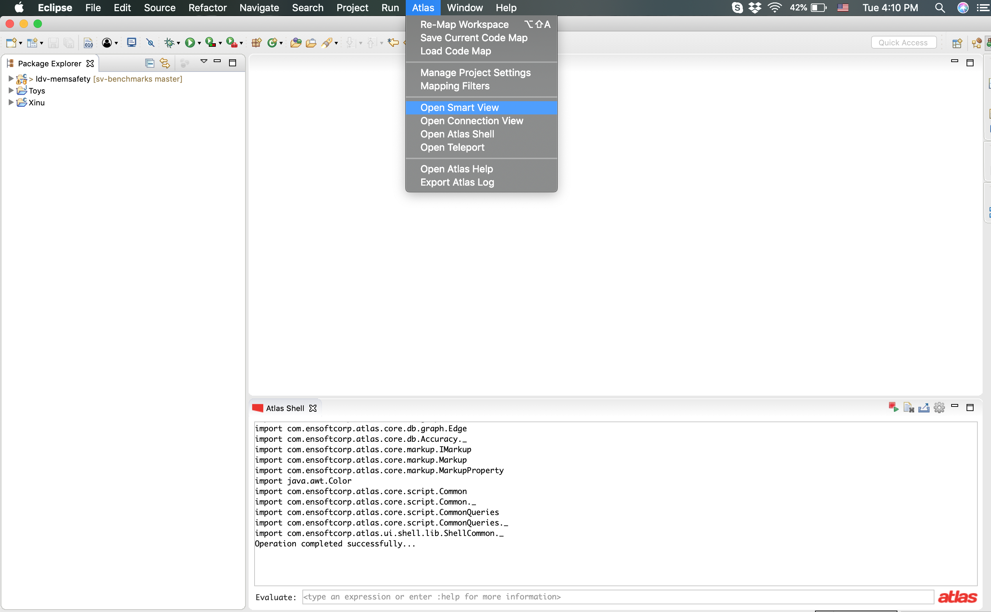
Hover to top of the screen to get the top bar.
Select Open Smart View from the Atlas menu.

Slide 4
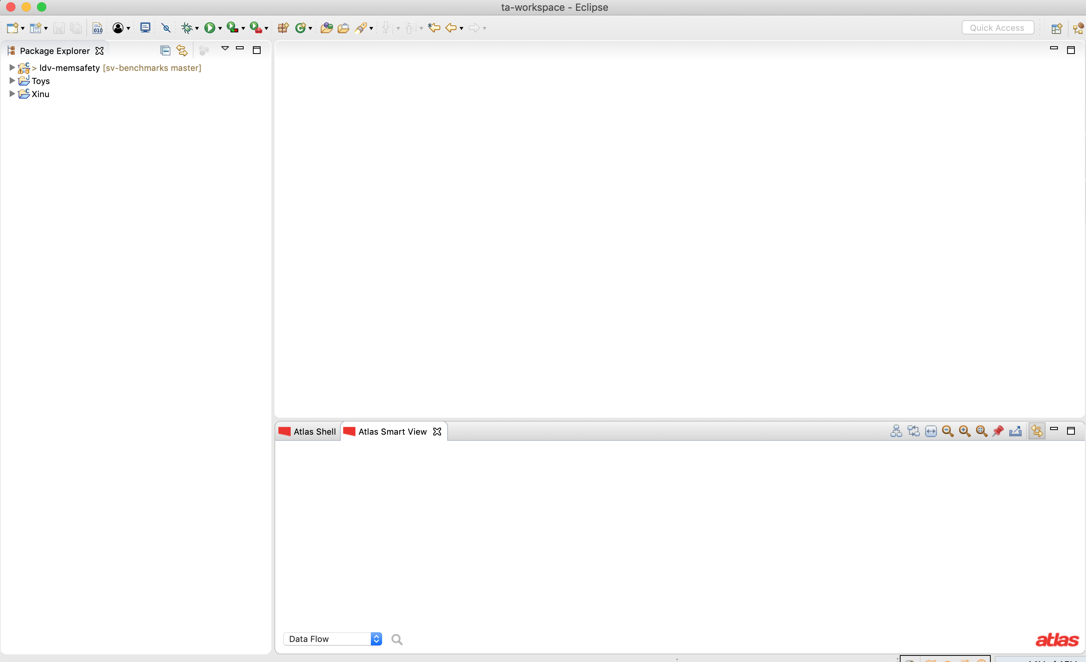
A new window opens in eclipse titled Atlas Smart View. Typically, it opens at the bottom of the screen. You can drag it to reposition as per your convenience.
Click and hold here to drag and reposition as shown on the next slide

Slide 5
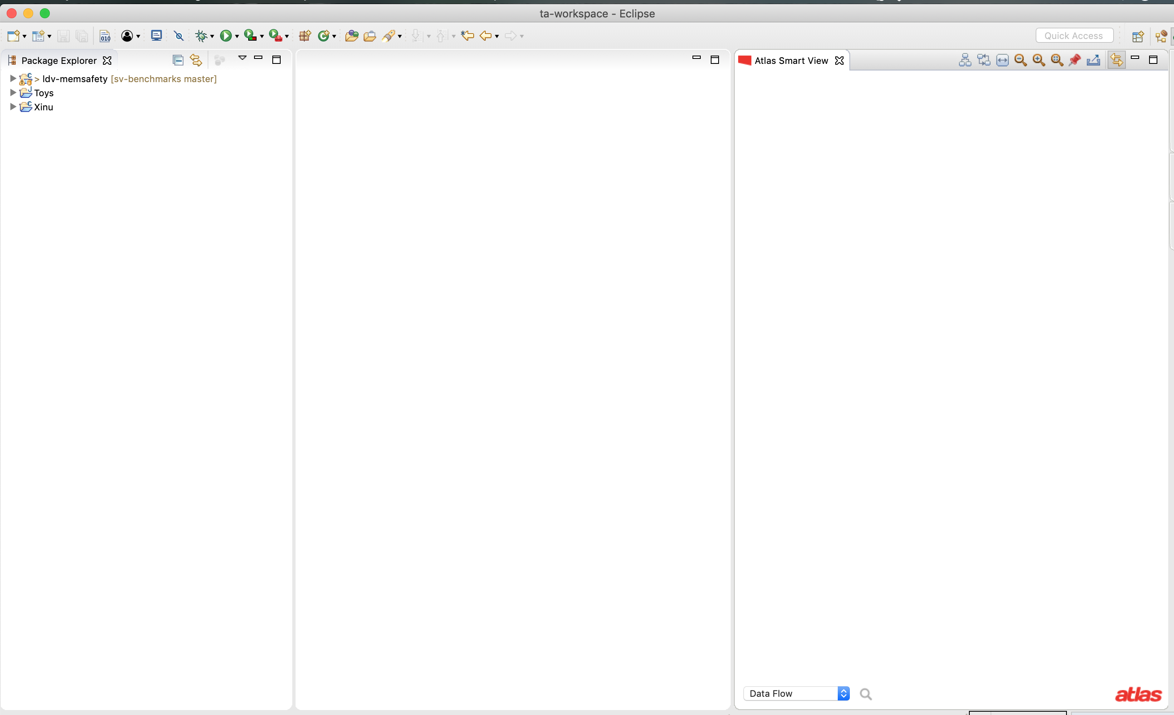
Like this

Slide 6
We will now demonstrate how to use smart views using the smart view Control Flow (within a function). This smart view comes with Toolbox Commons

Slide 7
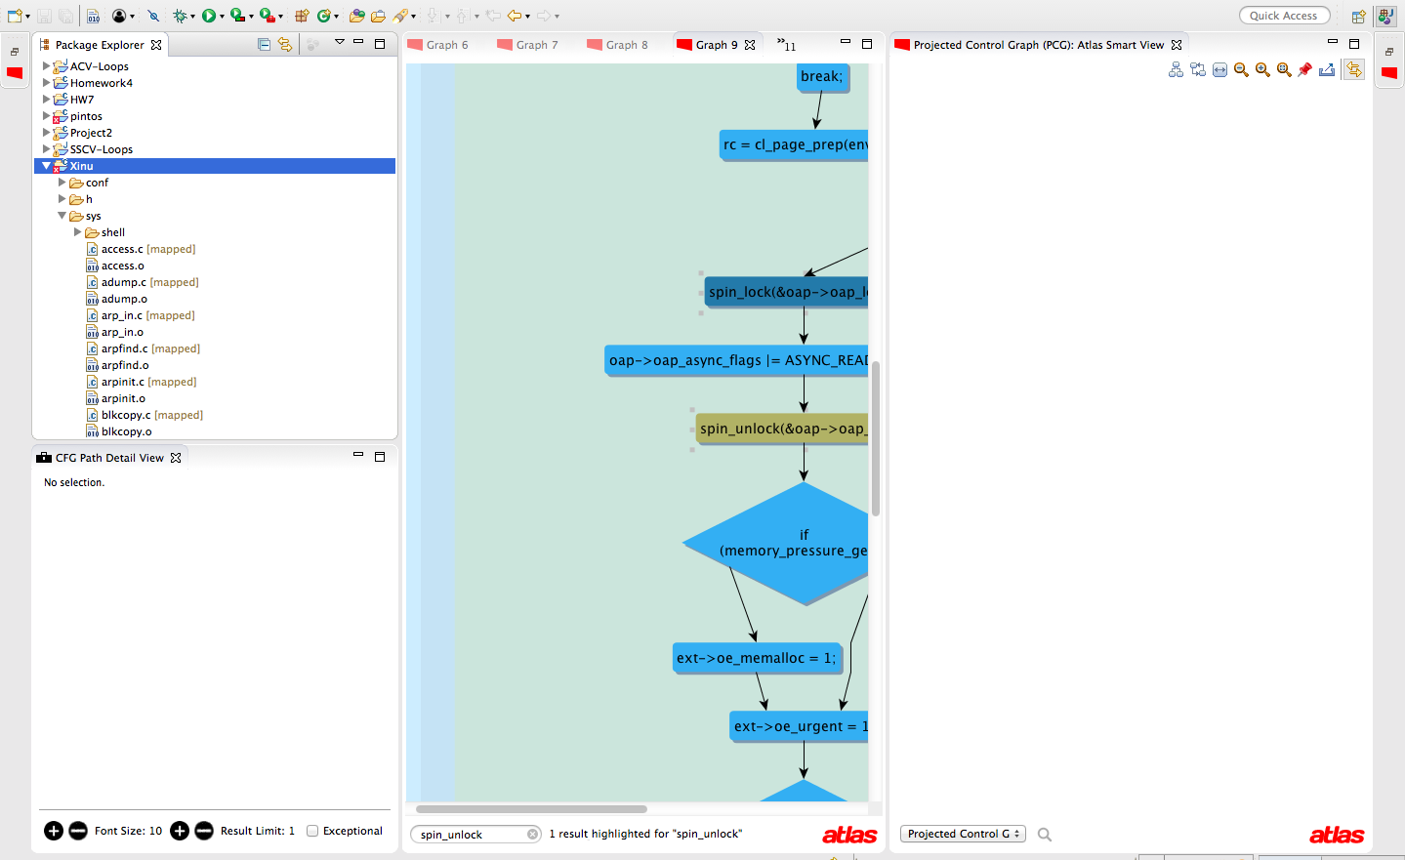
Expand “sys” to select the dskenq function for which we will generate and export the control flow graph (CFG).

Slide 8
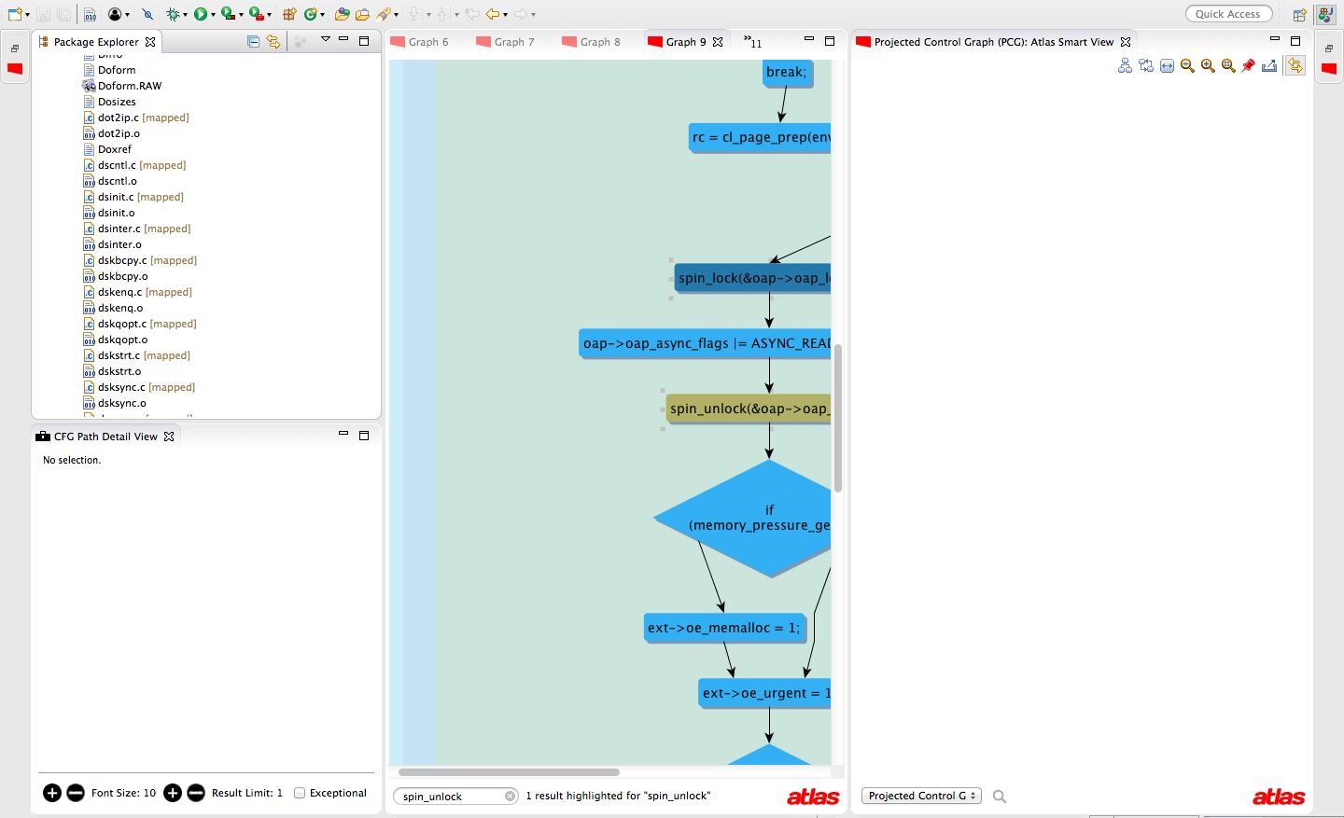

Slide 9
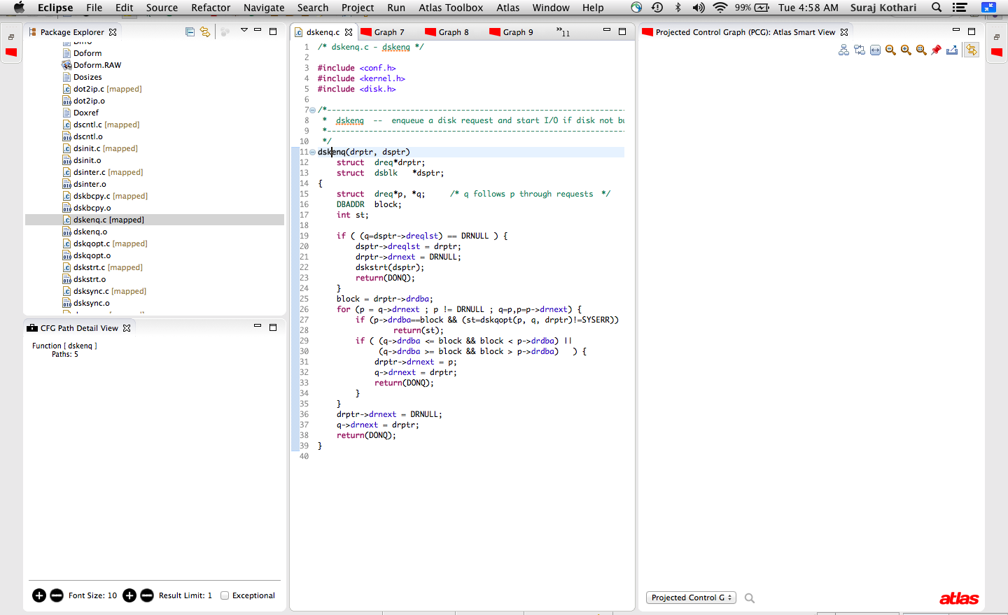
The SmartView is not the one we want. We need to change to the Control Flow (within a Function)
Click on dskenq
Result: the source code is shown.

Slide 10
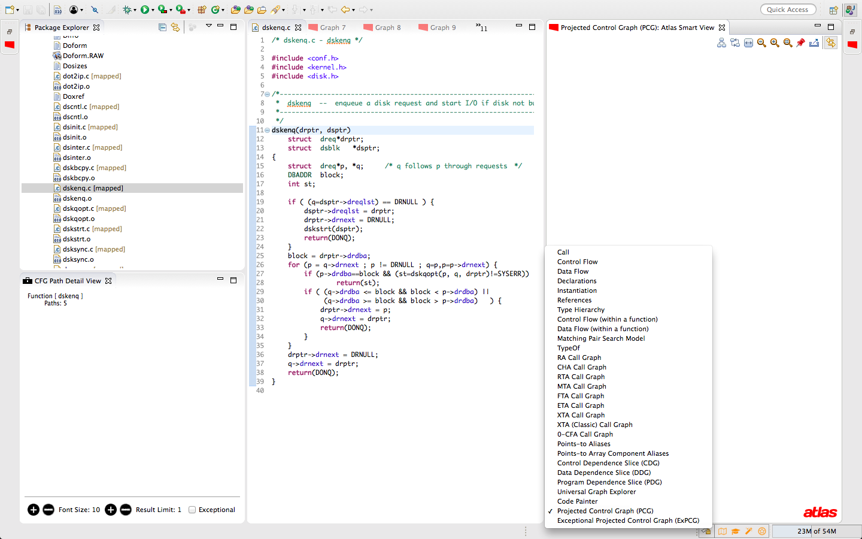

Slide 11
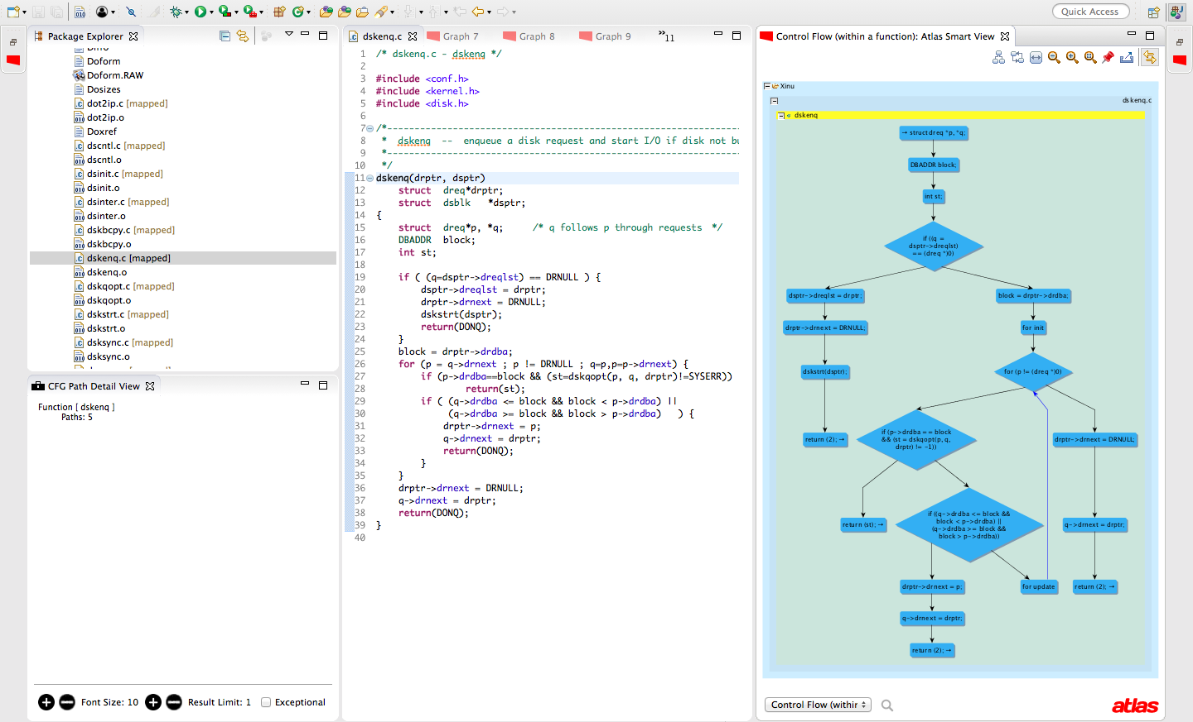
SmartView shows the control flow graph (CFG) for dskenq.

Slide 12
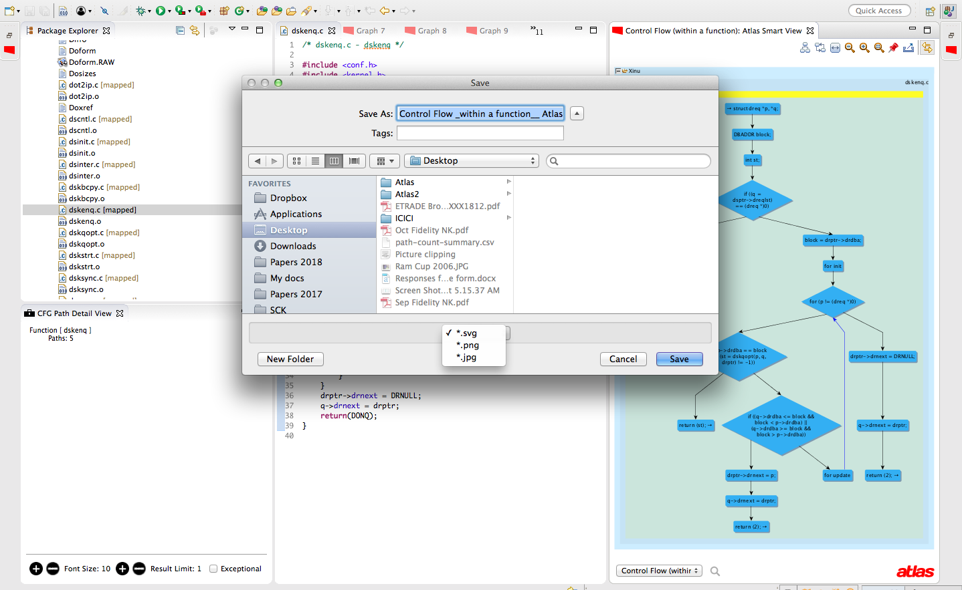
Export the CFG

Slide 13
Pipelining Smart Views
The next few slides show the following pipelining of Smart View:
The call Smart View is selected– shows the functions that call dskenq and the functions that are called by dskenq
The result of call Smart View is pinned
CFG Smart View is selected
Each node in the call View is a function, clicking on the node produces the CFG of that function
Pipelining:
Result 1
Result 2
Result 3
SmartView1
SmartView2
SmartView2
Output one one SmartView is used as the input for another SmartView

Slide 14
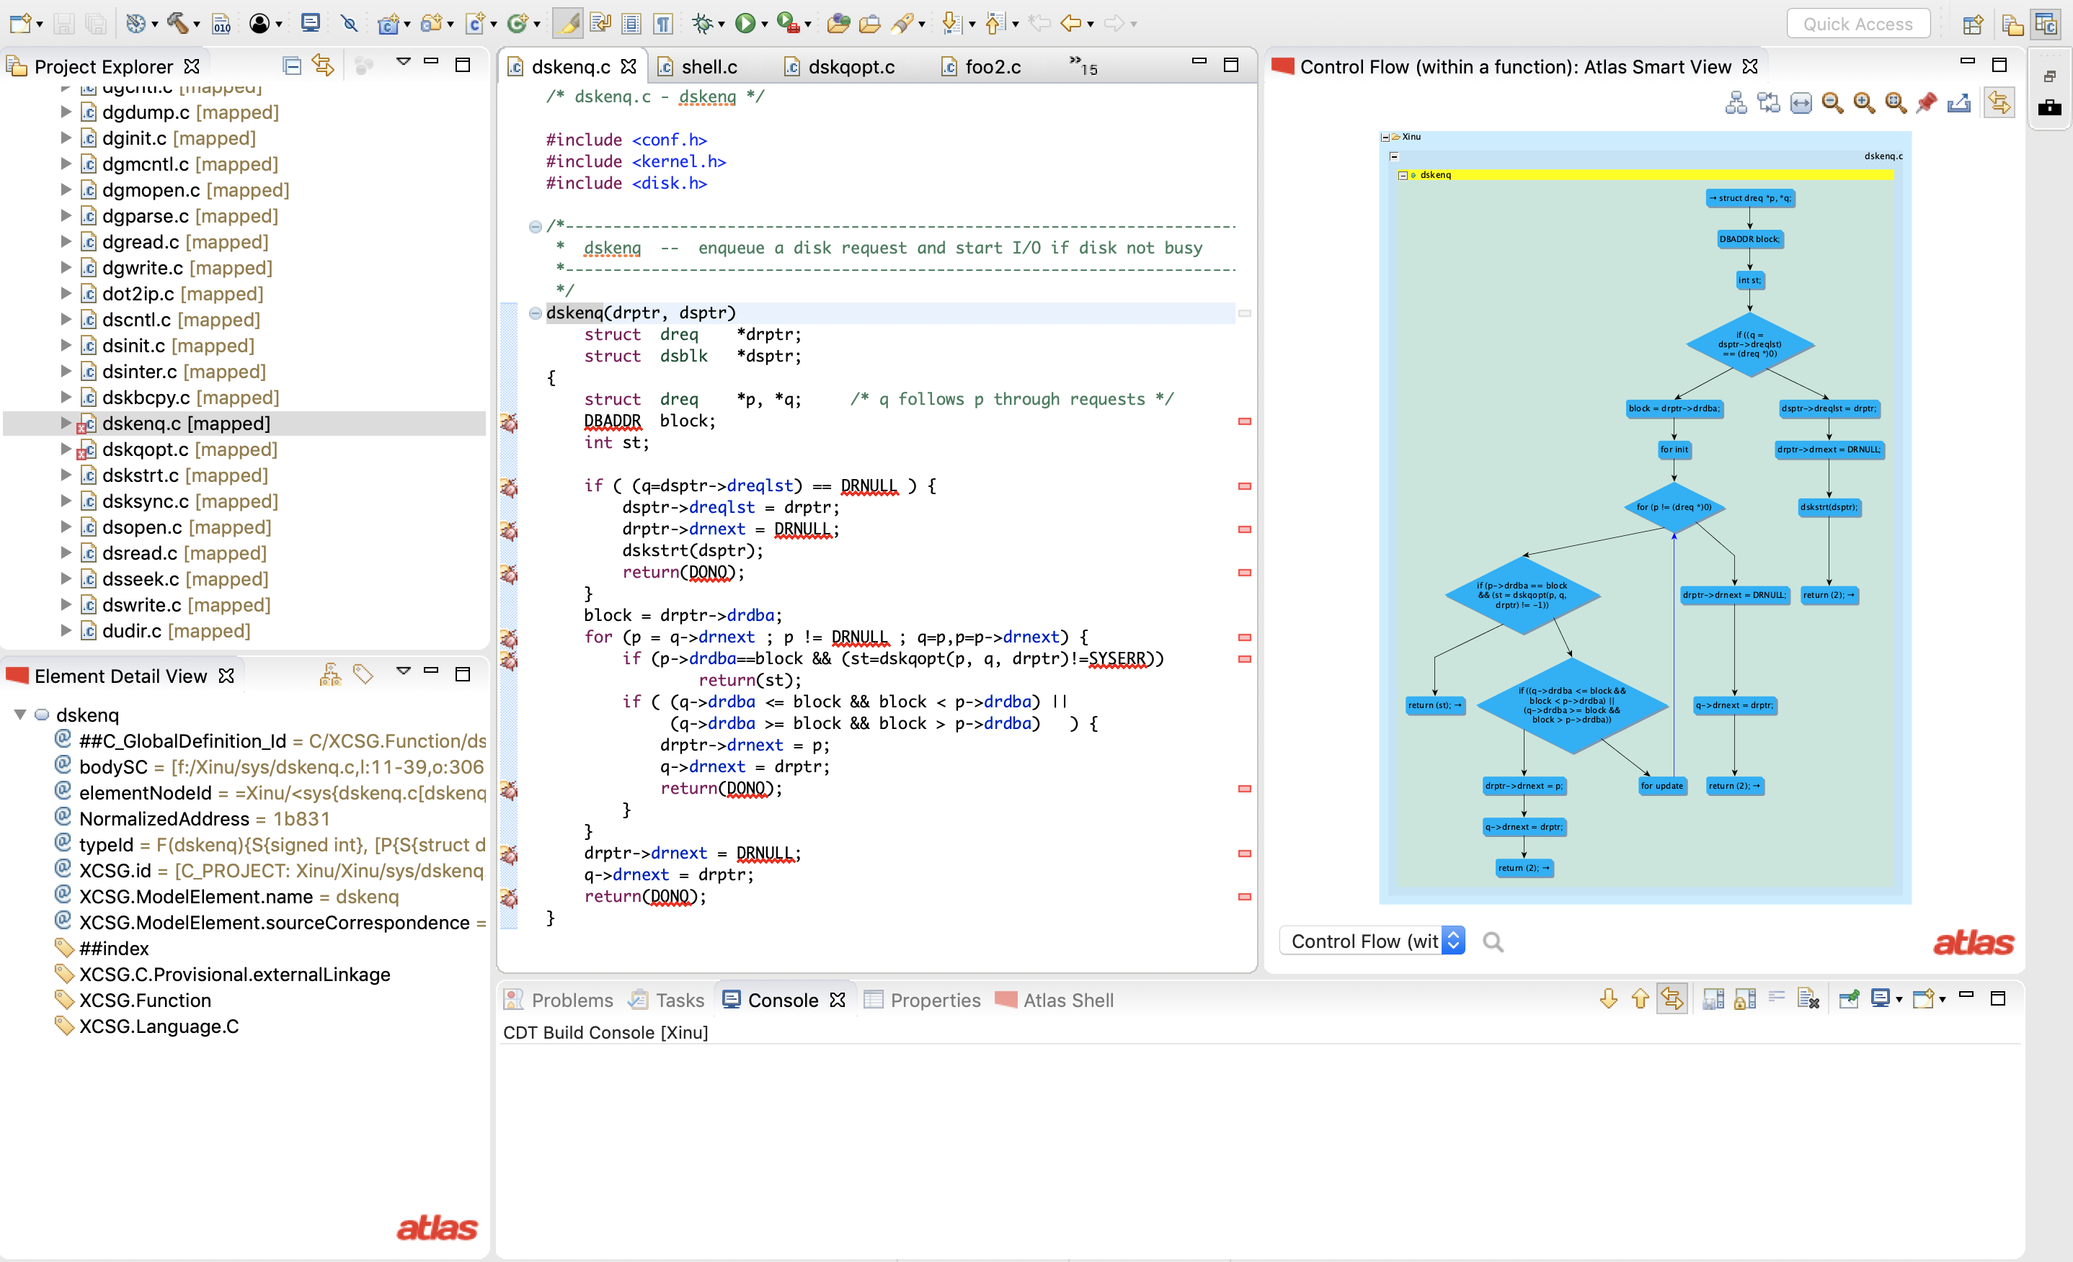
Click on a function name to select as the input for the CFG Smart View
Click to pin the model
Select Smart View

Slide 15
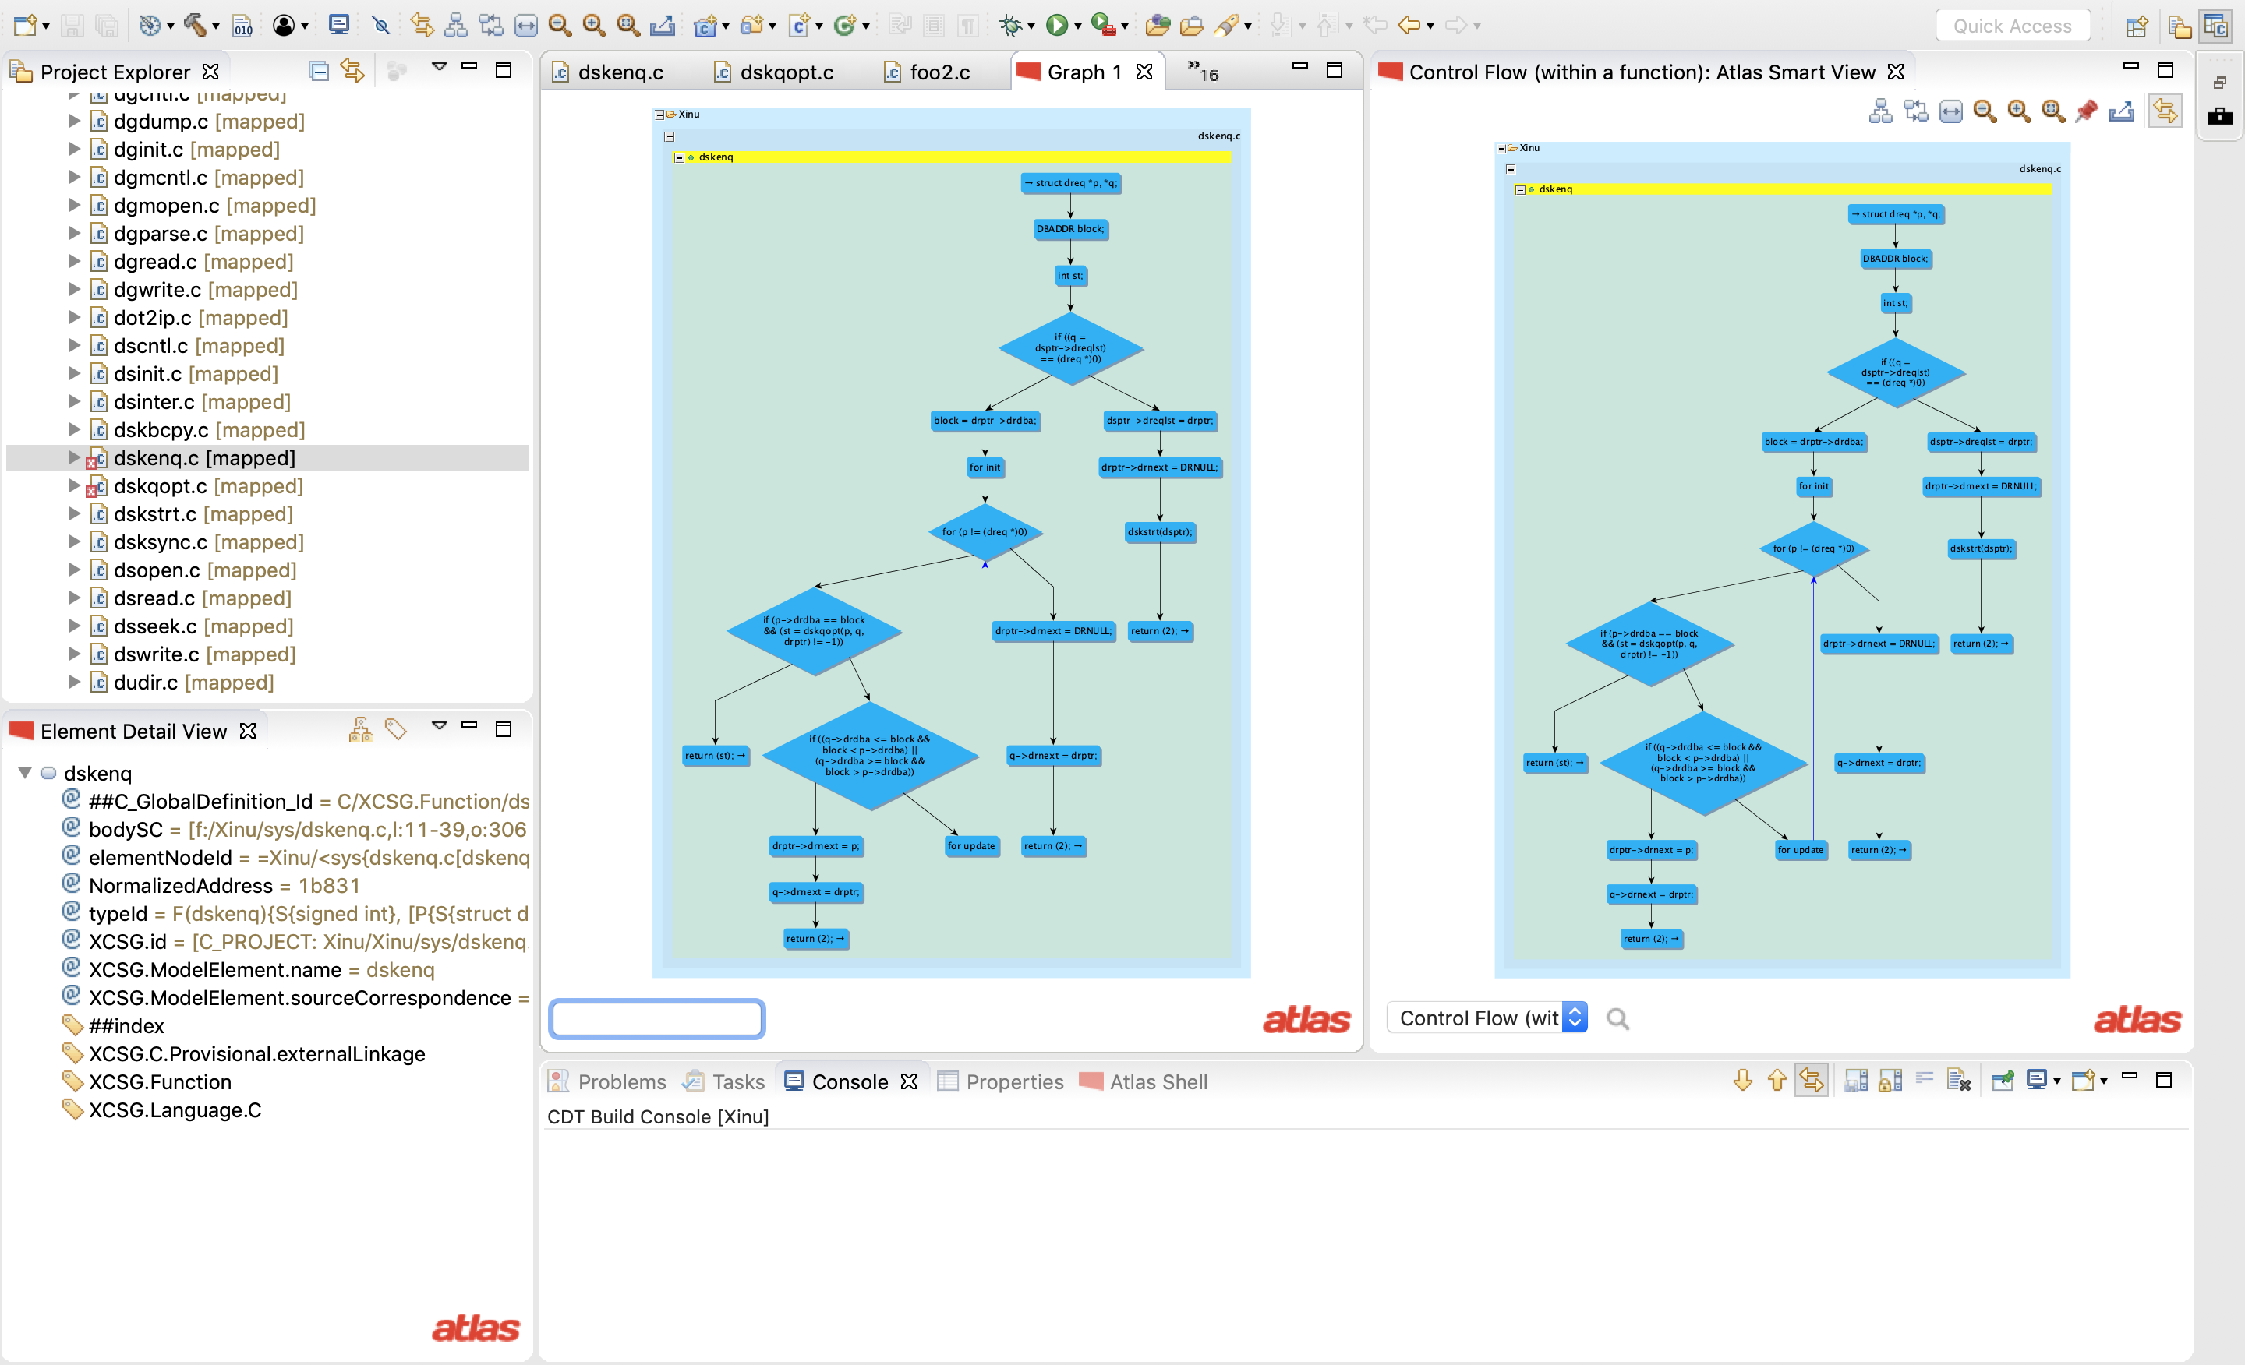
Pinned result

Slide 16
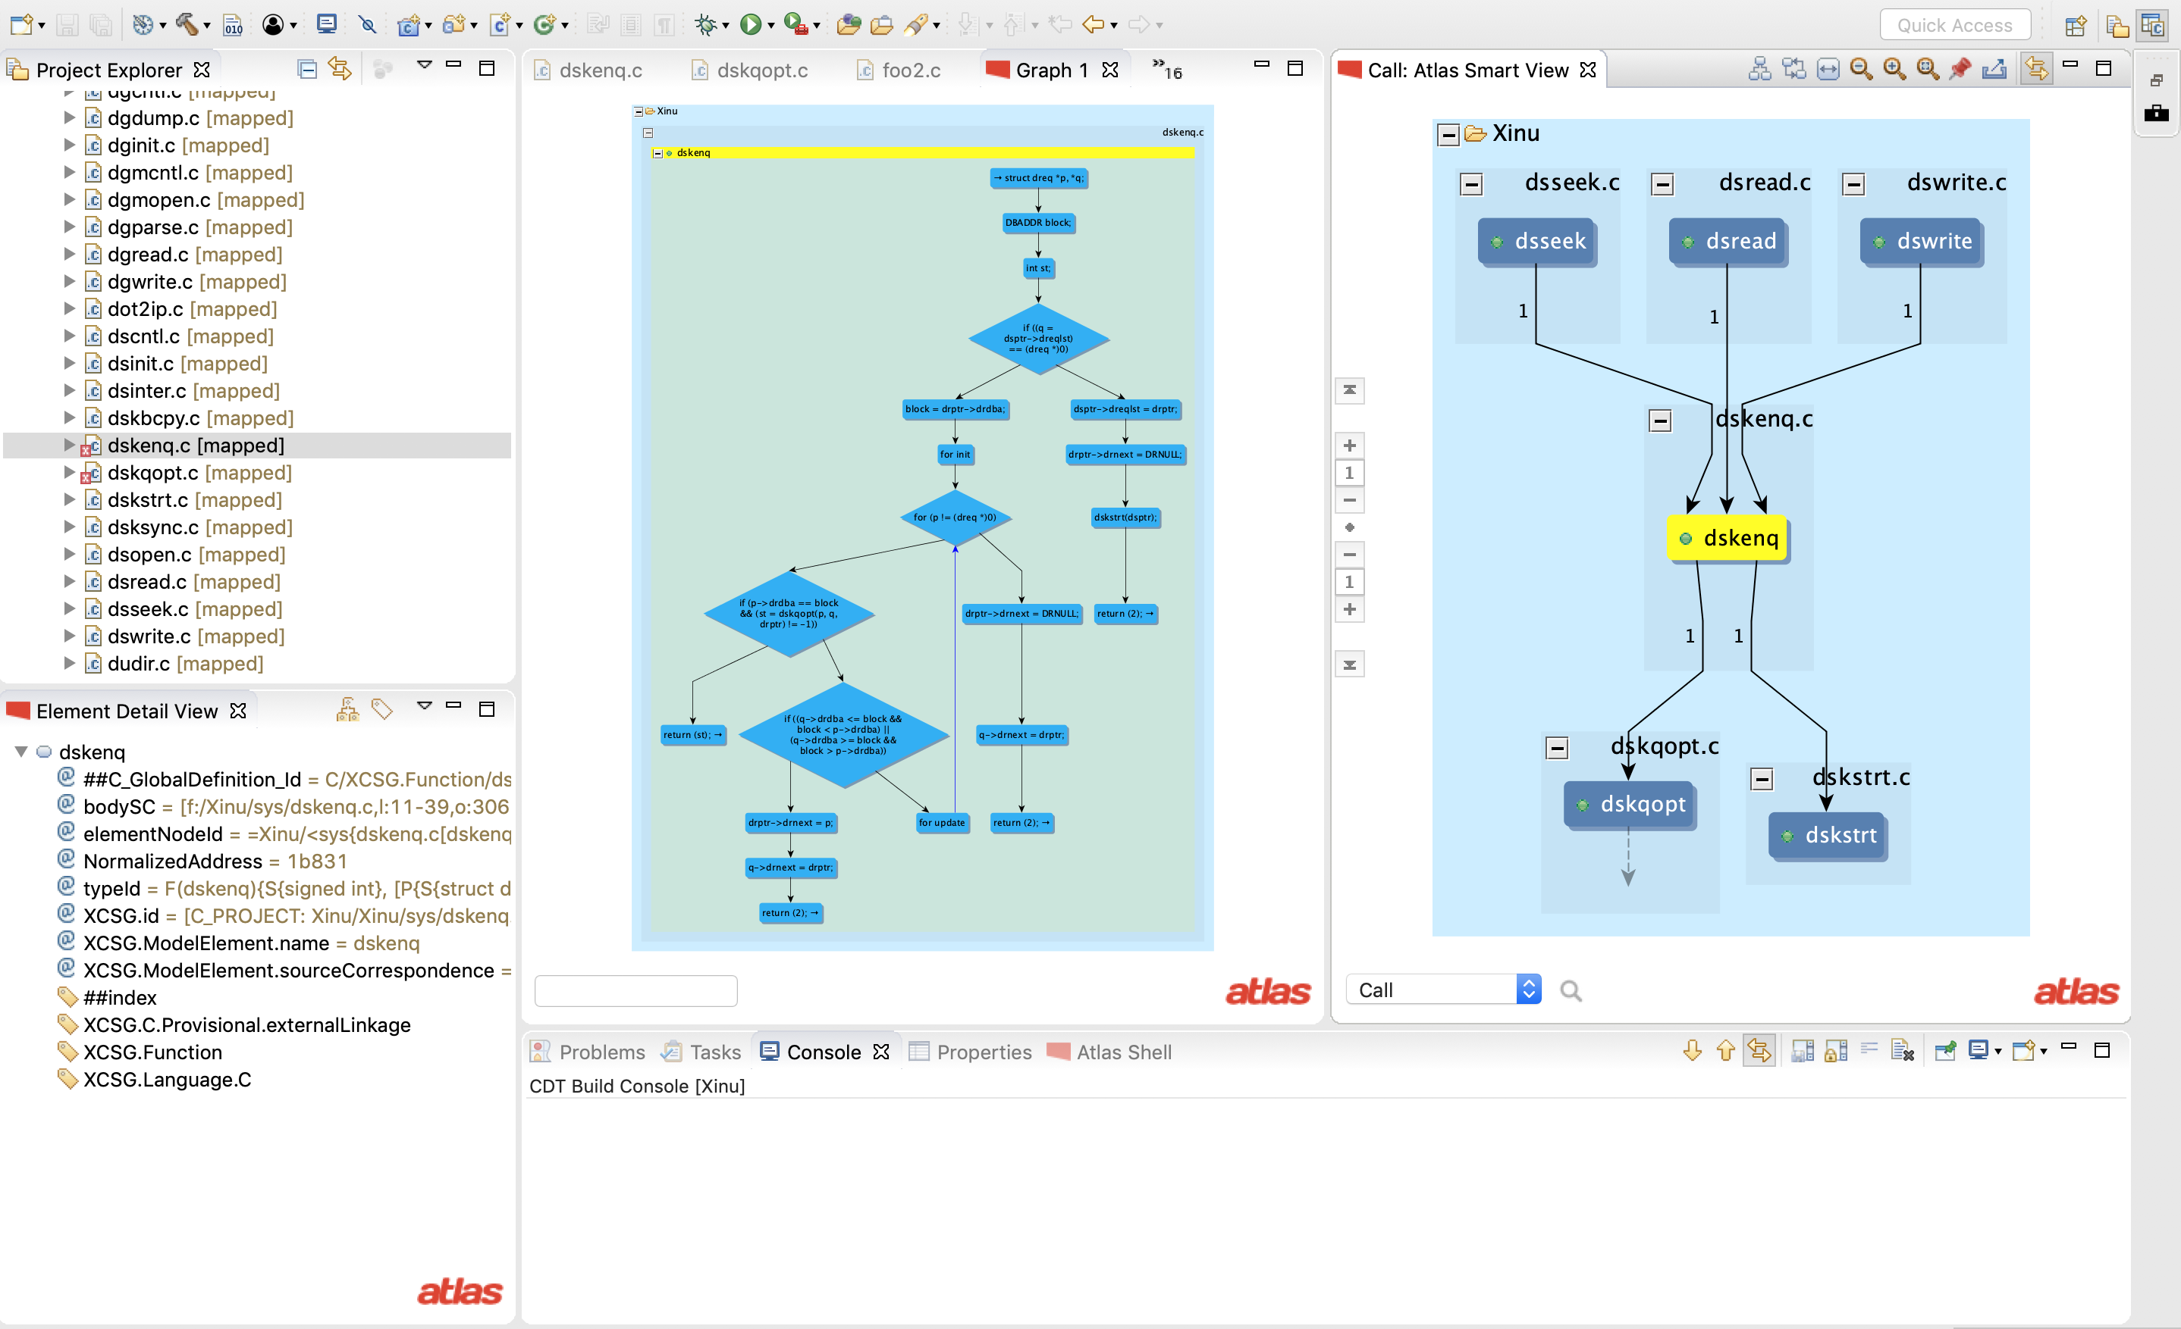
Call Graph of dskenq
Select call Smart View

Slide 17
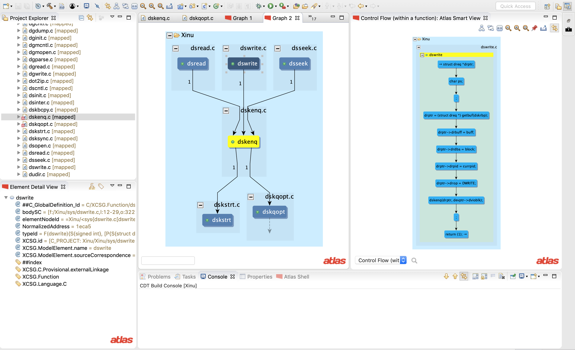
Click on dswrite
Call graph is pinned
CFG of dswrite
Select CFG SmartView

Slide 18
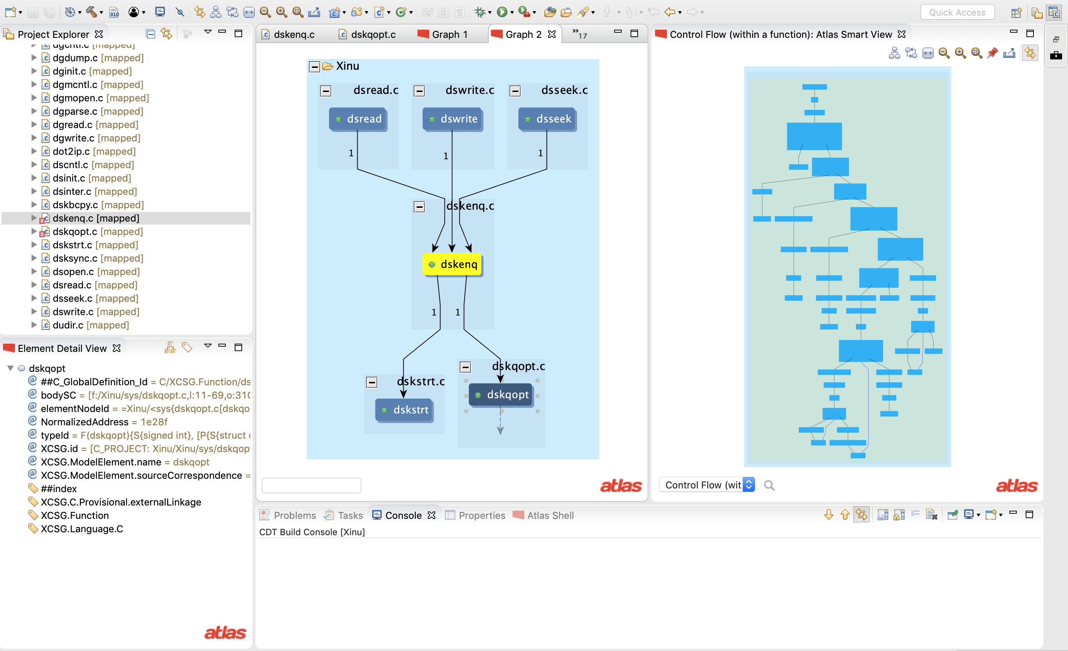
Click on dskqopt
CFG of dskqopt
Select CFG SmartView

Slide 19
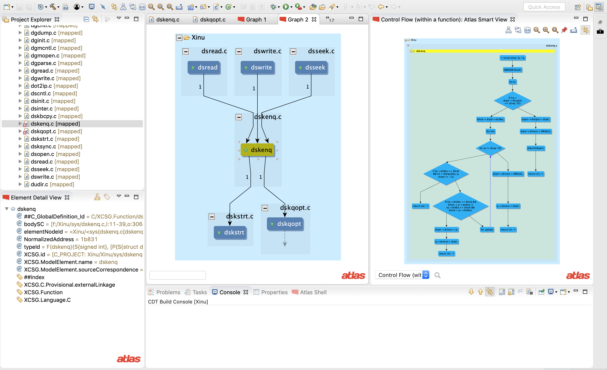
Click on dskenq
CFG of dskenq

Slide 20
Atlas Shell is the query interpreter for Atlas. We will demonstrate its use.

Slide 21
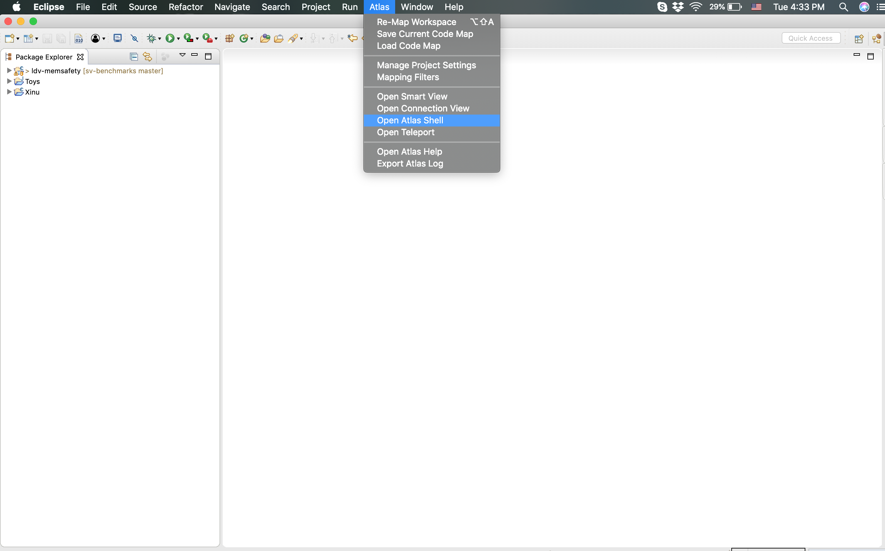
Hover to top of the screen to get the top bar.
Select Open Atlas Shell
from the Atlas menu.

Slide 22
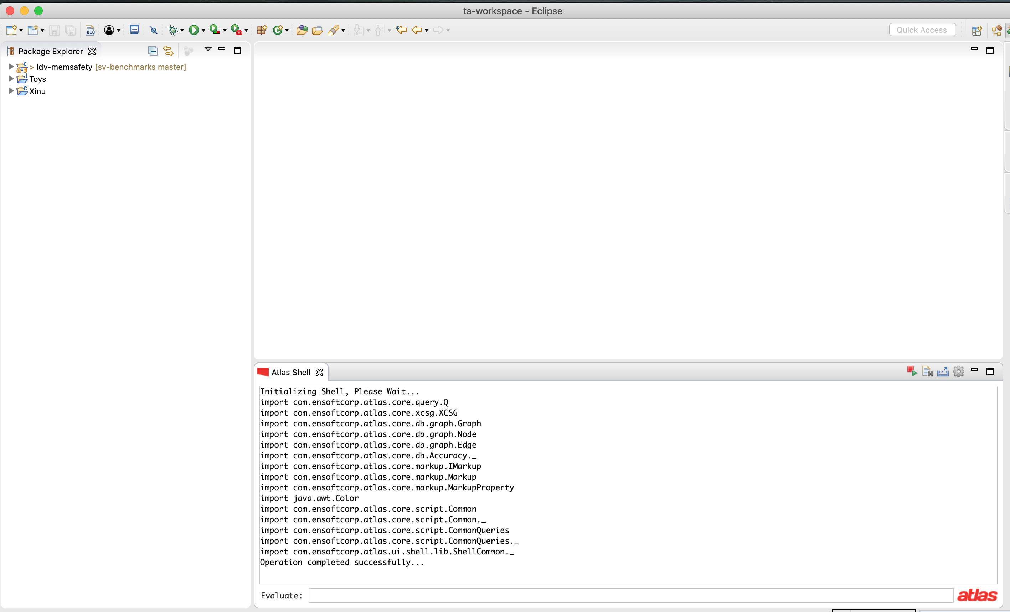
A new window titled Atlas Shell opens.
Typically it opens at the bottom of your screen. Drag it to reposition as per your convenience.

Slide 23
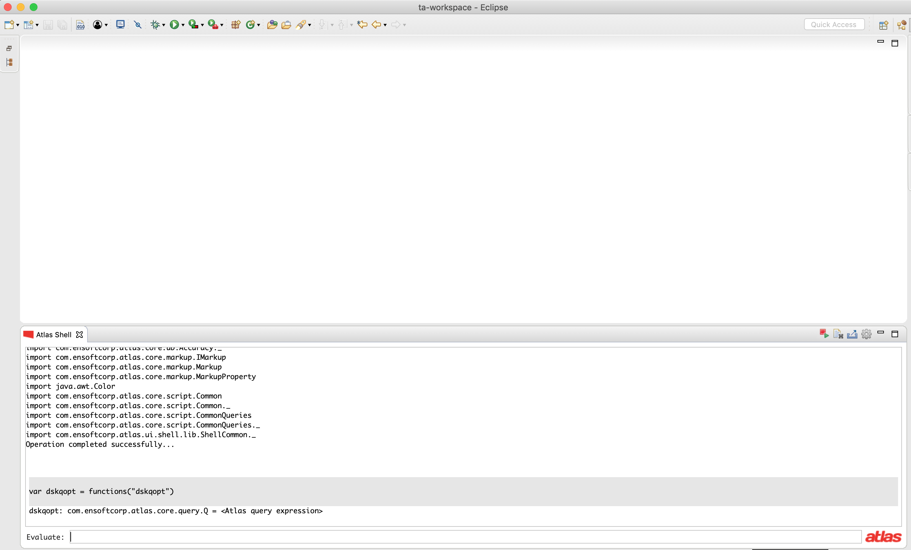
Counting Program Artifacts
We will execute queries to count:
Loops (Nested, Non-nested)
Branches
We choose a function first
1. var dskqopt = functions("dskqopt")

Slide 24
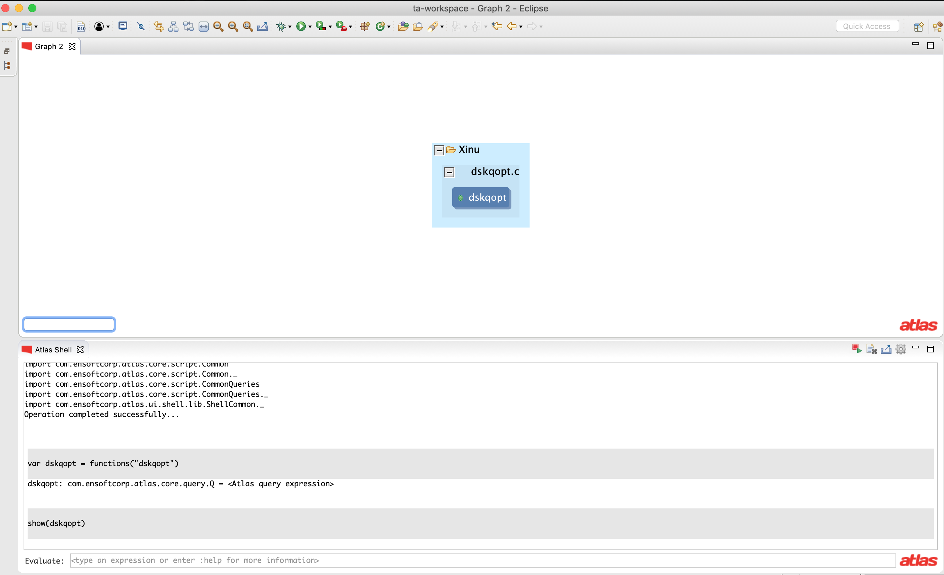
var dskqopt = functions("dskqopt")
show(dskqopt)

Slide 25
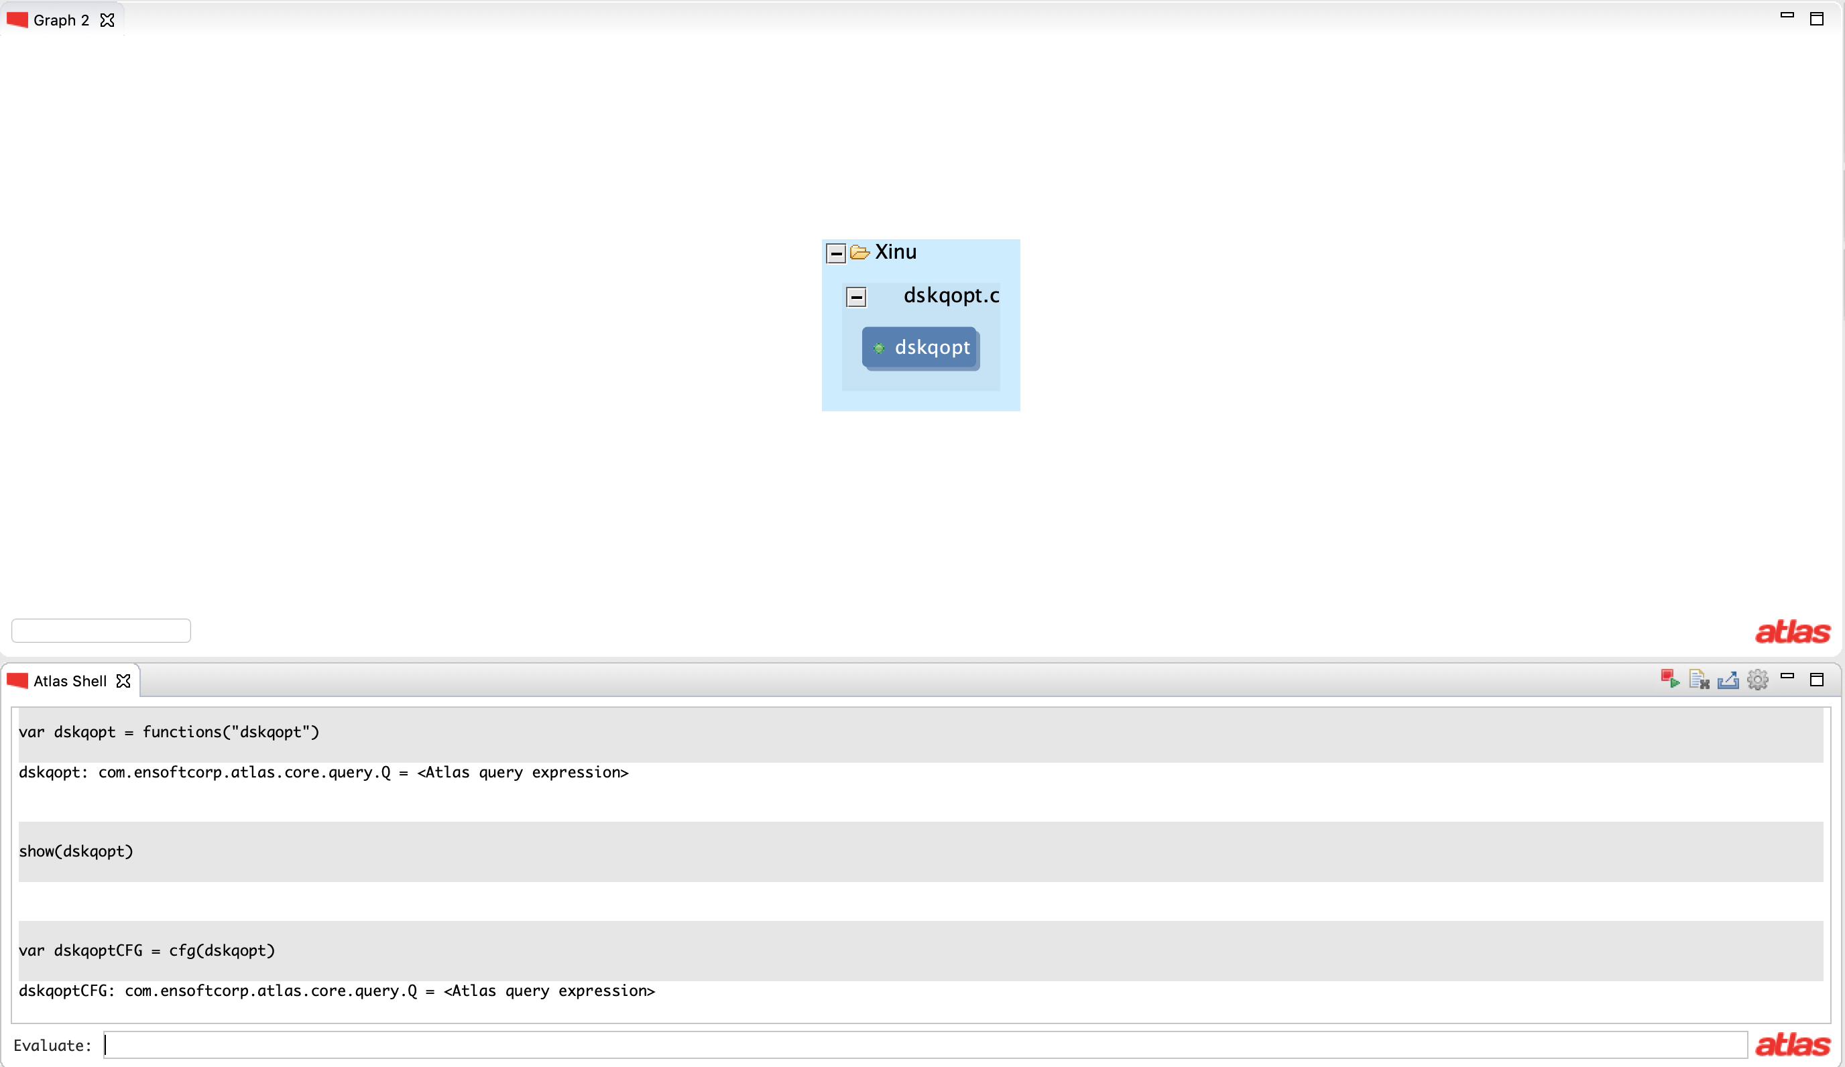
var dskqopt = functions("dskqopt")
show(dskqopt)
var dskqoptCFG = cfg(dskqopt)

Slide 26
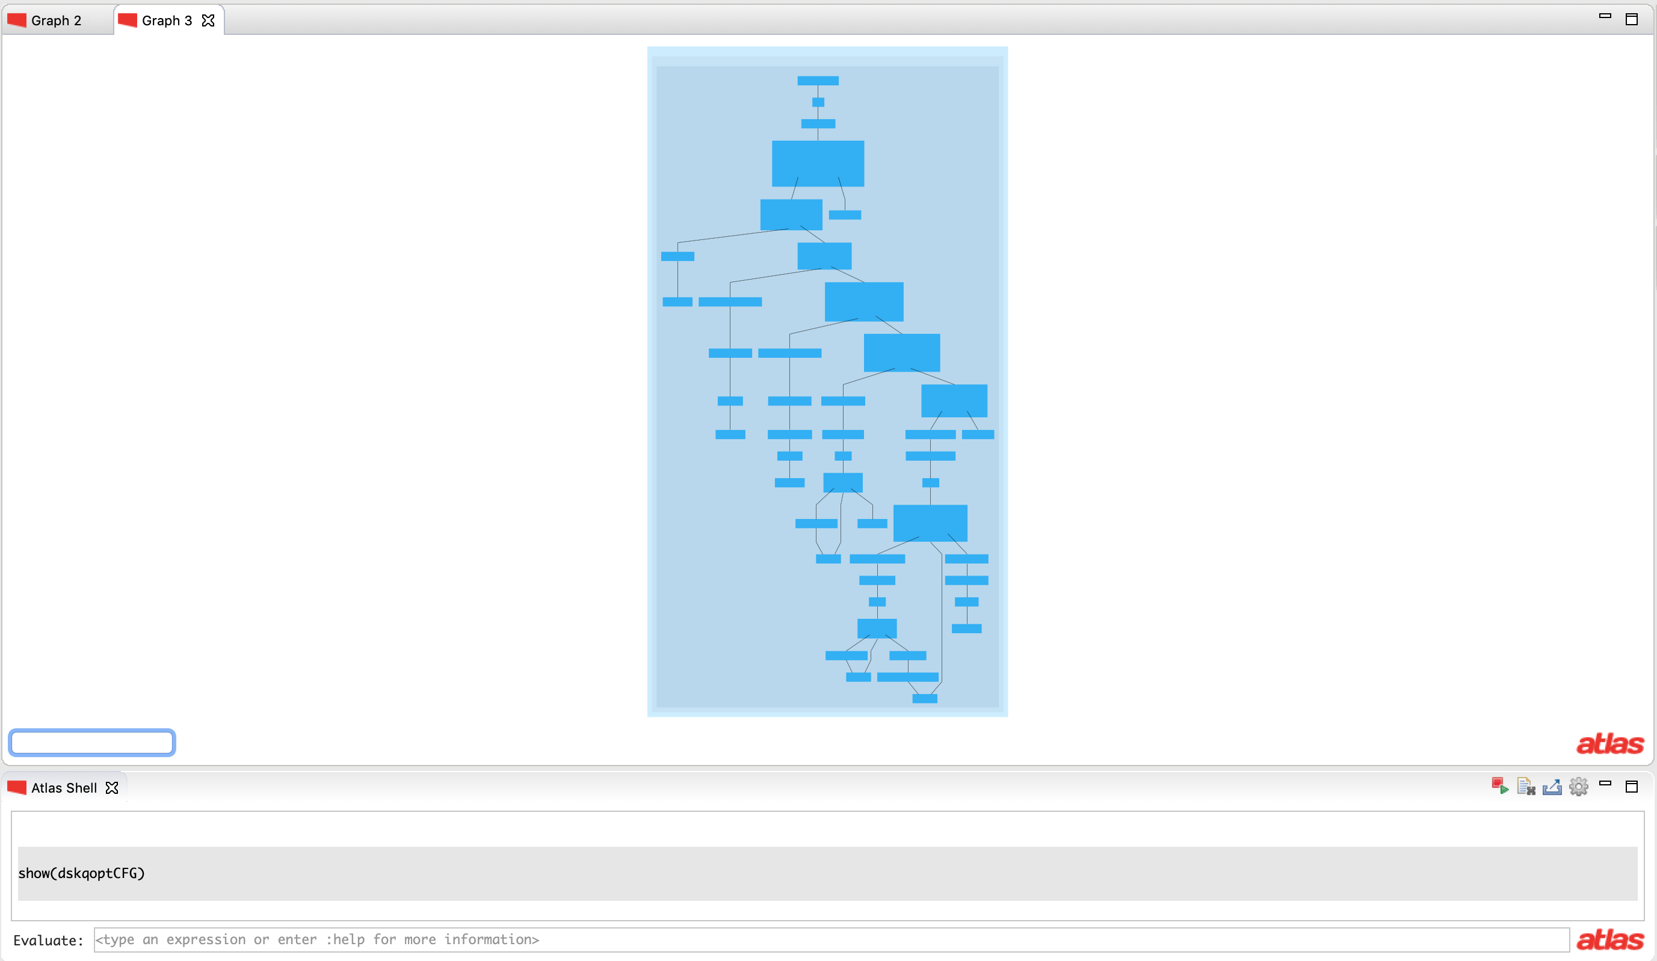
var dskqopt = functions("dskqopt")
show(dskqopt)
var dskqoptCFG = cfg(dskqopt)
show(dskqoptCFG)

Slide 27
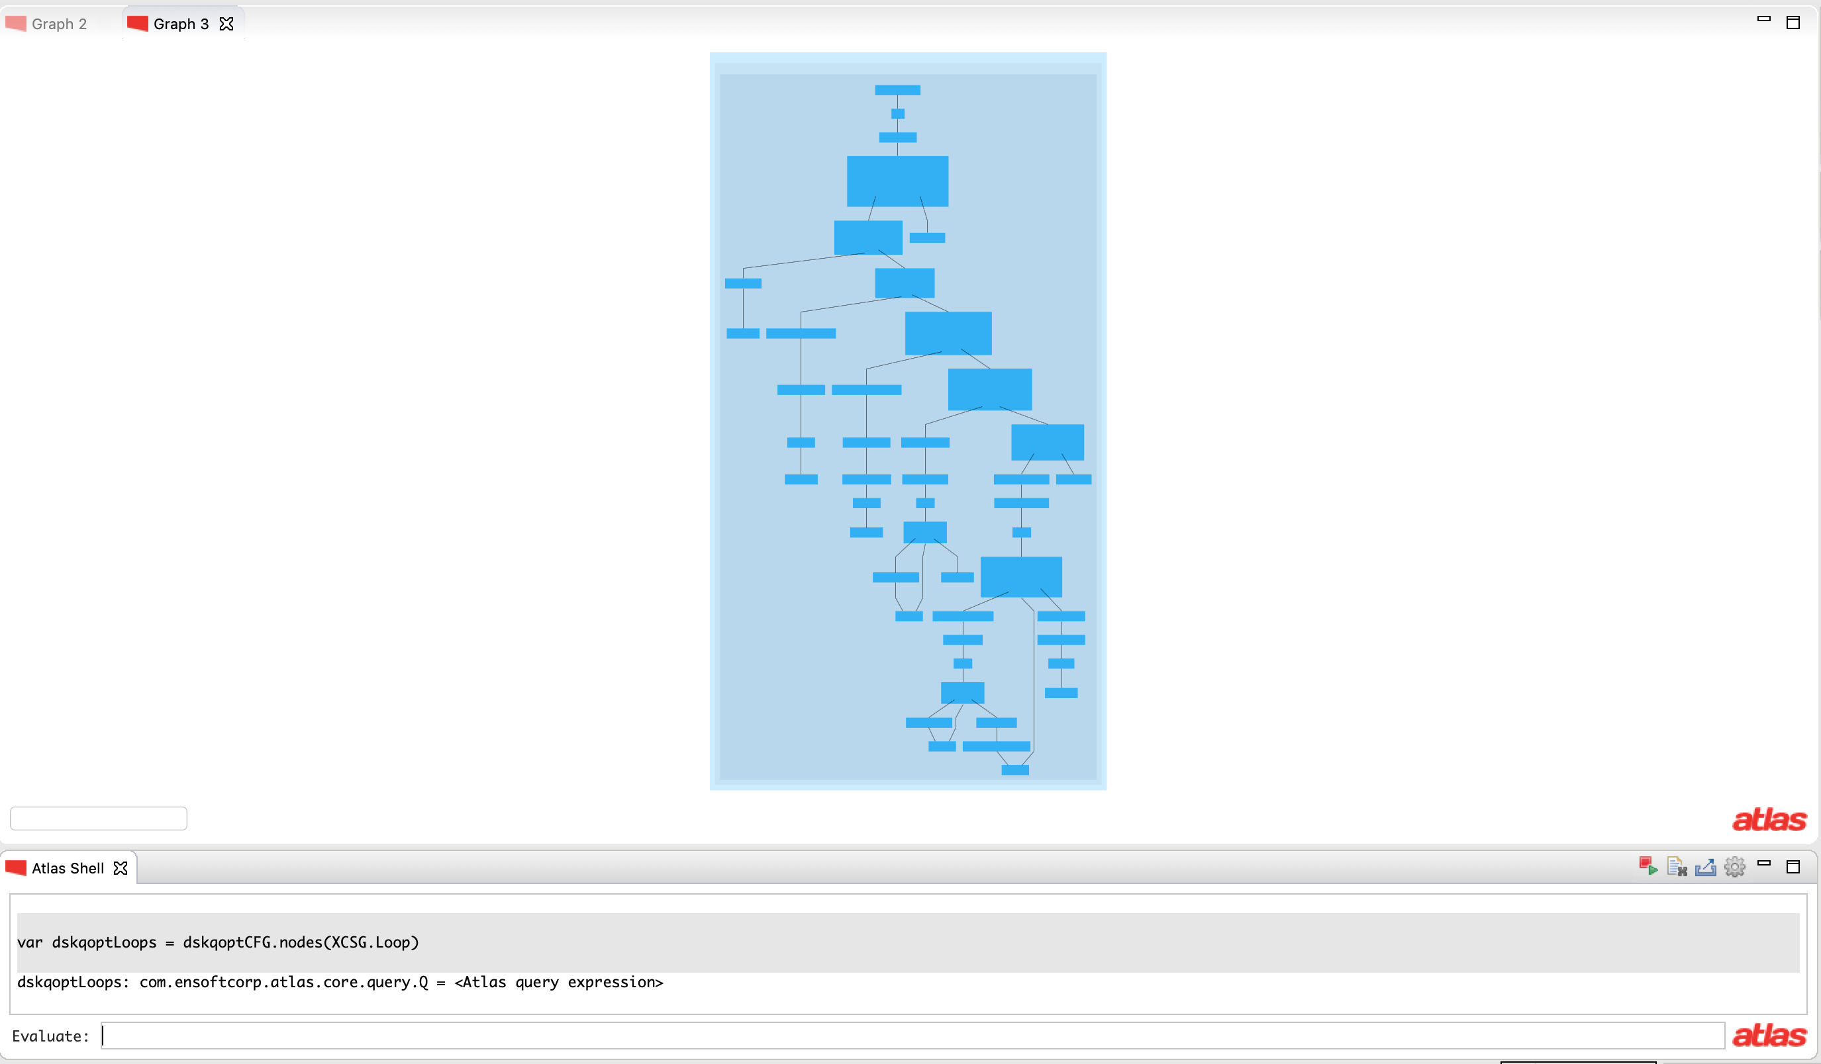
var dskqopt = functions("dskqopt")
show(dskqopt)
var dskqoptCFG = cfg(dskqopt)
show(dskqoptCFG)
var dskqoptLoops = dskqoptCFG.nodes(XCSG.Loop)

Slide 28
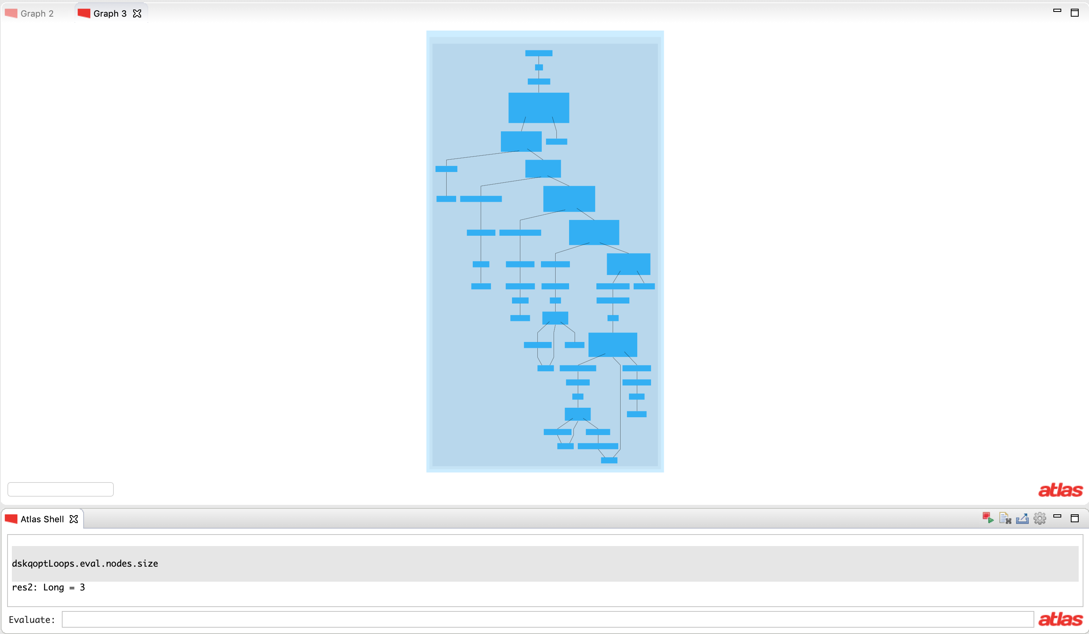
var dskqopt = functions("dskqopt")
show(dskqopt)
var dskqoptCFG = cfg(dskqopt)
show(dskqoptCFG)
var dskqoptLoops = dskqoptCFG.nodes(XCSG.Loop)
dskqoptLoops.eval.nodes.size
There are 3 loops
in this function

Slide 29
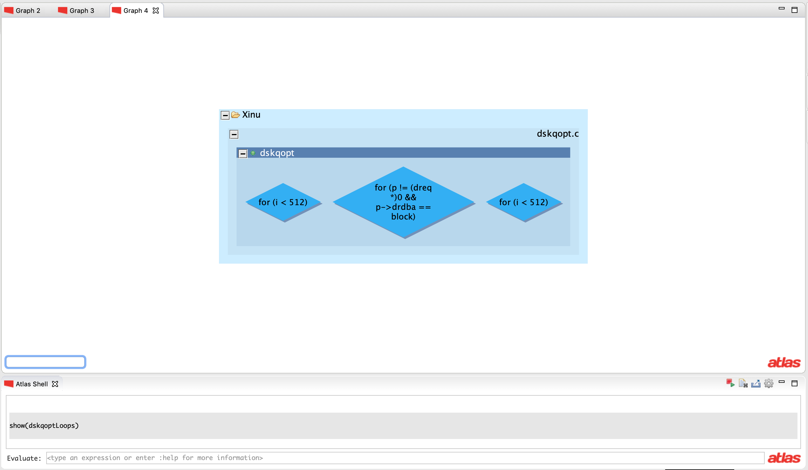
var dskqopt = functions("dskqopt")
show(dskqopt)
var dskqoptCFG = cfg(dskqopt)
show(dskqoptCFG)
var dskqoptLoops = dskqoptCFG.nodes(XCSG.Loop)
dskqoptLoops.eval.nodes.size
show(dskqoptLoops)

Slide 30
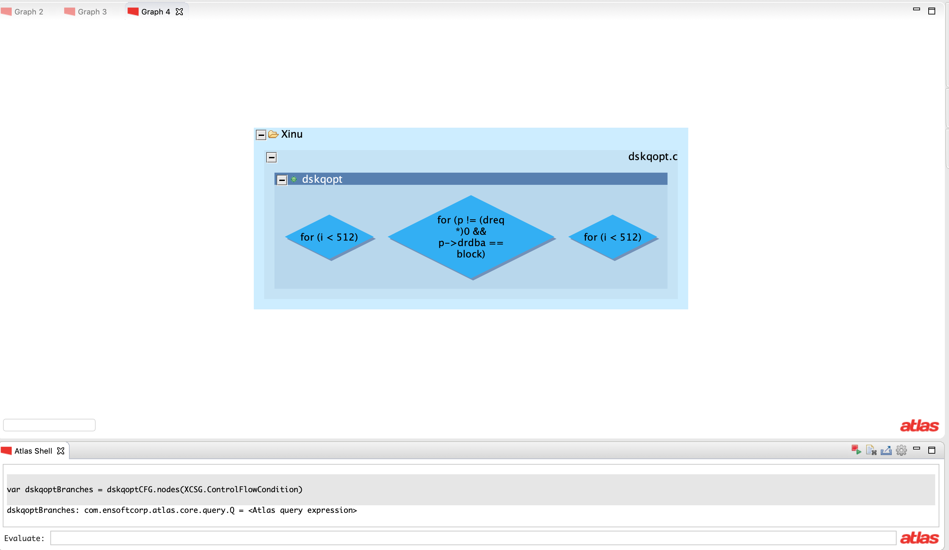
var dskqopt = functions("dskqopt")
show(dskqopt)
var dskqoptCFG = cfg(dskqopt)
show(dskqoptCFG)
var dskqoptLoops = dskqoptCFG.nodes(XCSG.Loop)
dskqoptLoops.eval.nodes.size
show(dskqoptLoops)
var dskqoptBranches =
dskqoptCFG.nodes(XCSG.ControlFlowCondition)

Slide 31
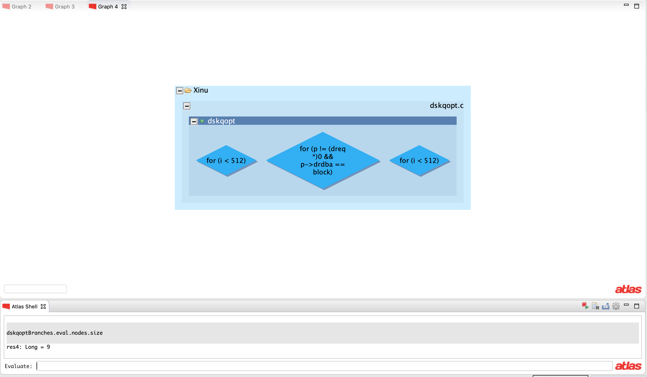
var dskqopt = functions("dskqopt")
show(dskqopt)
var dskqoptCFG = cfg(dskqopt)
show(dskqoptCFG)
var dskqoptLoops = dskqoptCFG.nodes(XCSG.Loop)
dskqoptLoops.eval.nodes.size
show(dskqoptLoops)
var dskqoptBranches =
dskqoptCFG.nodes(XCSG.ControlFlowCondition)
dskqoptBranches.eval.nodes.size
There are 9 branches
in this function

Slide 32
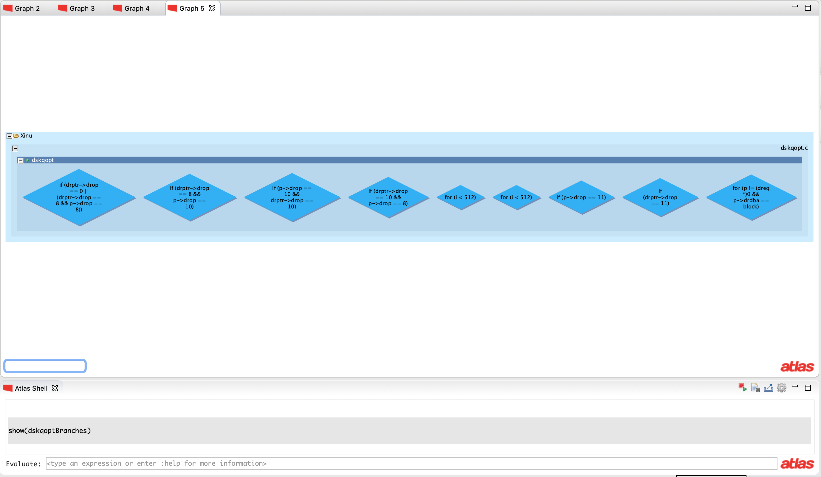
var dskqopt = functions("dskqopt")
show(dskqopt)
var dskqoptCFG = cfg(dskqopt)
show(dskqoptCFG)
var dskqoptLoops = dskqoptCFG.nodes(XCSG.Loop)
dskqoptLoops.eval.nodes.size
show(dskqoptLoops)
var dskqoptBranches =
dskqoptCFG.nodes(XCSG.ControlFlowCondition)
dskqoptBranches.eval.nodes.size
show(dskqoptBranches)

Slide 33
Let’s count nested and non-nested loops now

Slide 34
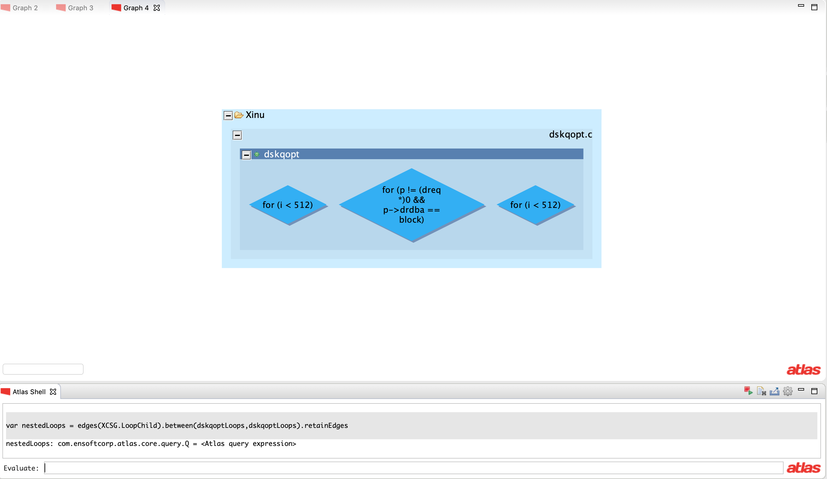
11. var nestedLoops = edges(XCSG.LoopChild).between(dskqoptLoops,dskqoptLoops).retainEdges

Slide 35
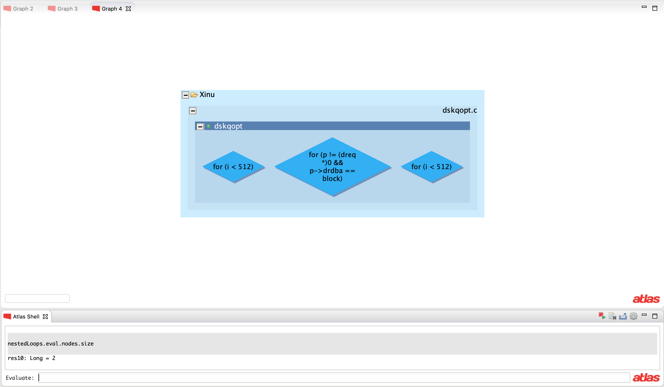
12. nestedLoops.eval.nodes.size
There are 2 nested loops
in this function

Slide 36
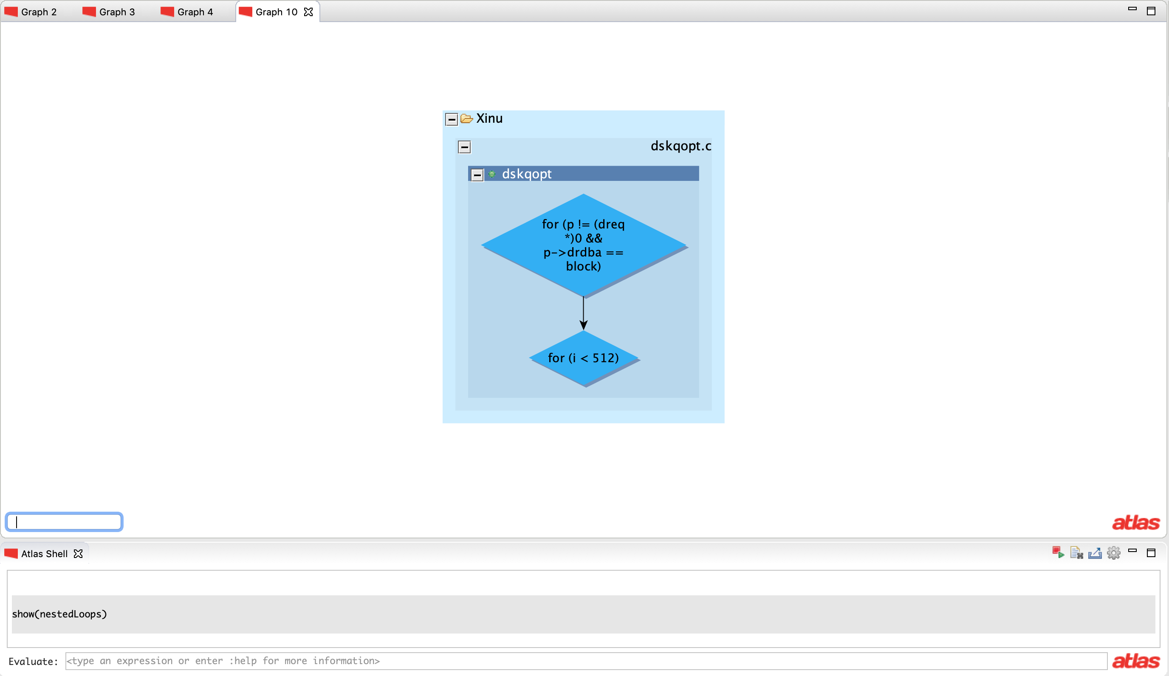
13. show(nestedLoops)

Slide 37
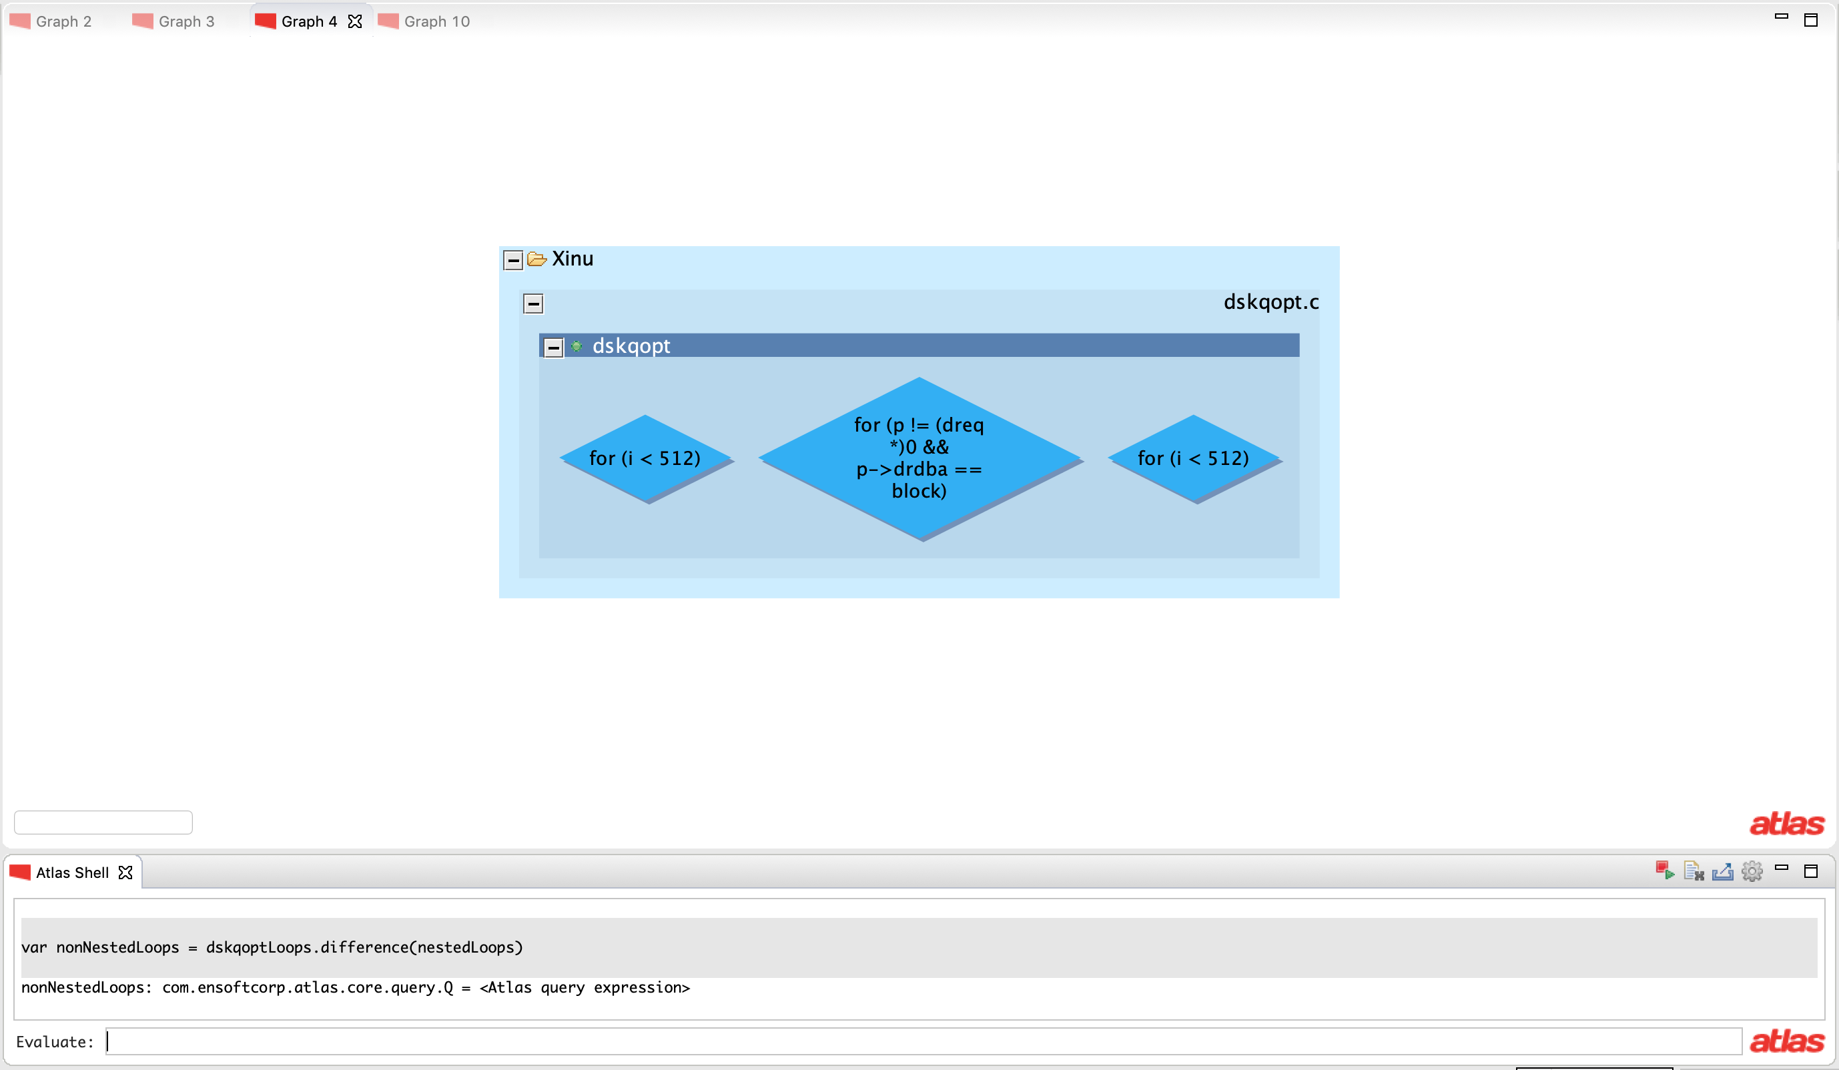
14. var nonNestedLoops = dskqoptLoops.difference(nestedLoops)

Slide 38
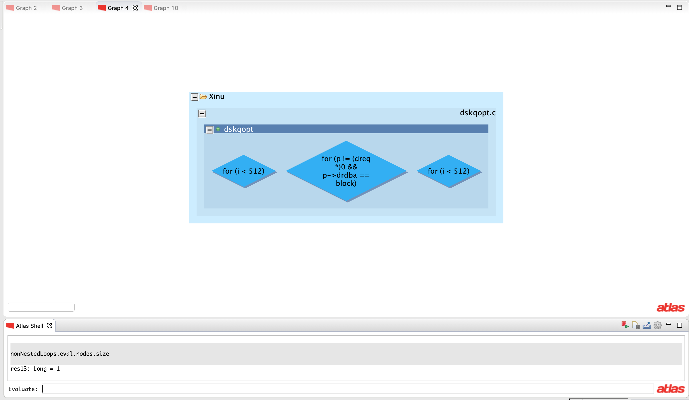
15. nonNestedLoops.eval.nodes.size
There is 1 non-nested loop
in this function

Slide 39
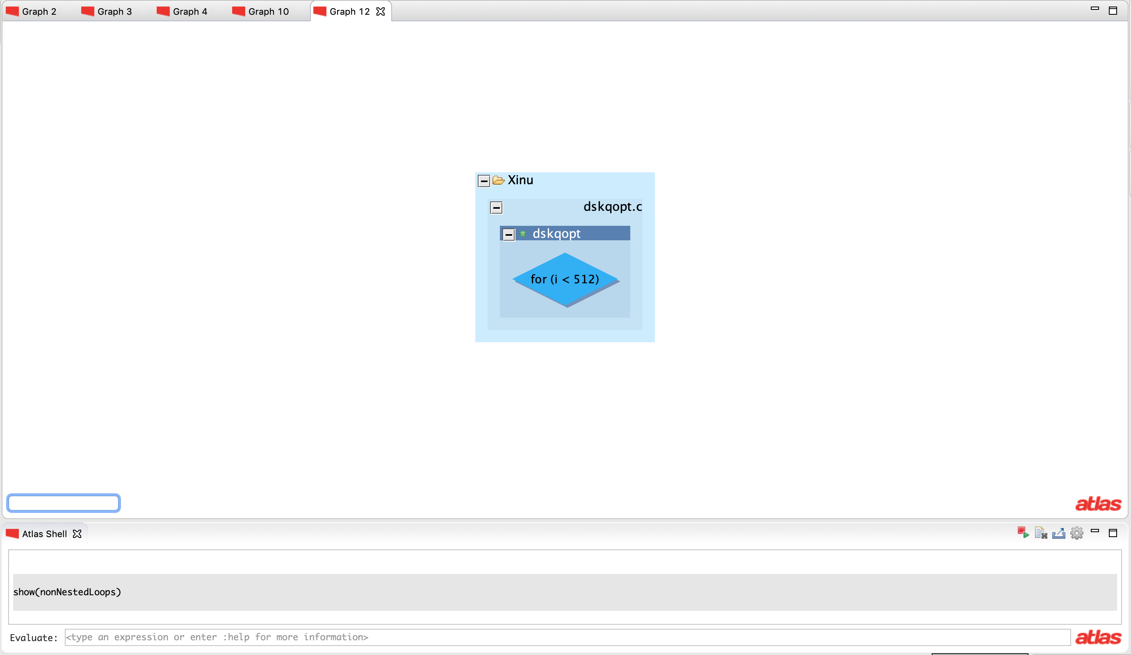
show(nonNestedLoops)

Slide 40
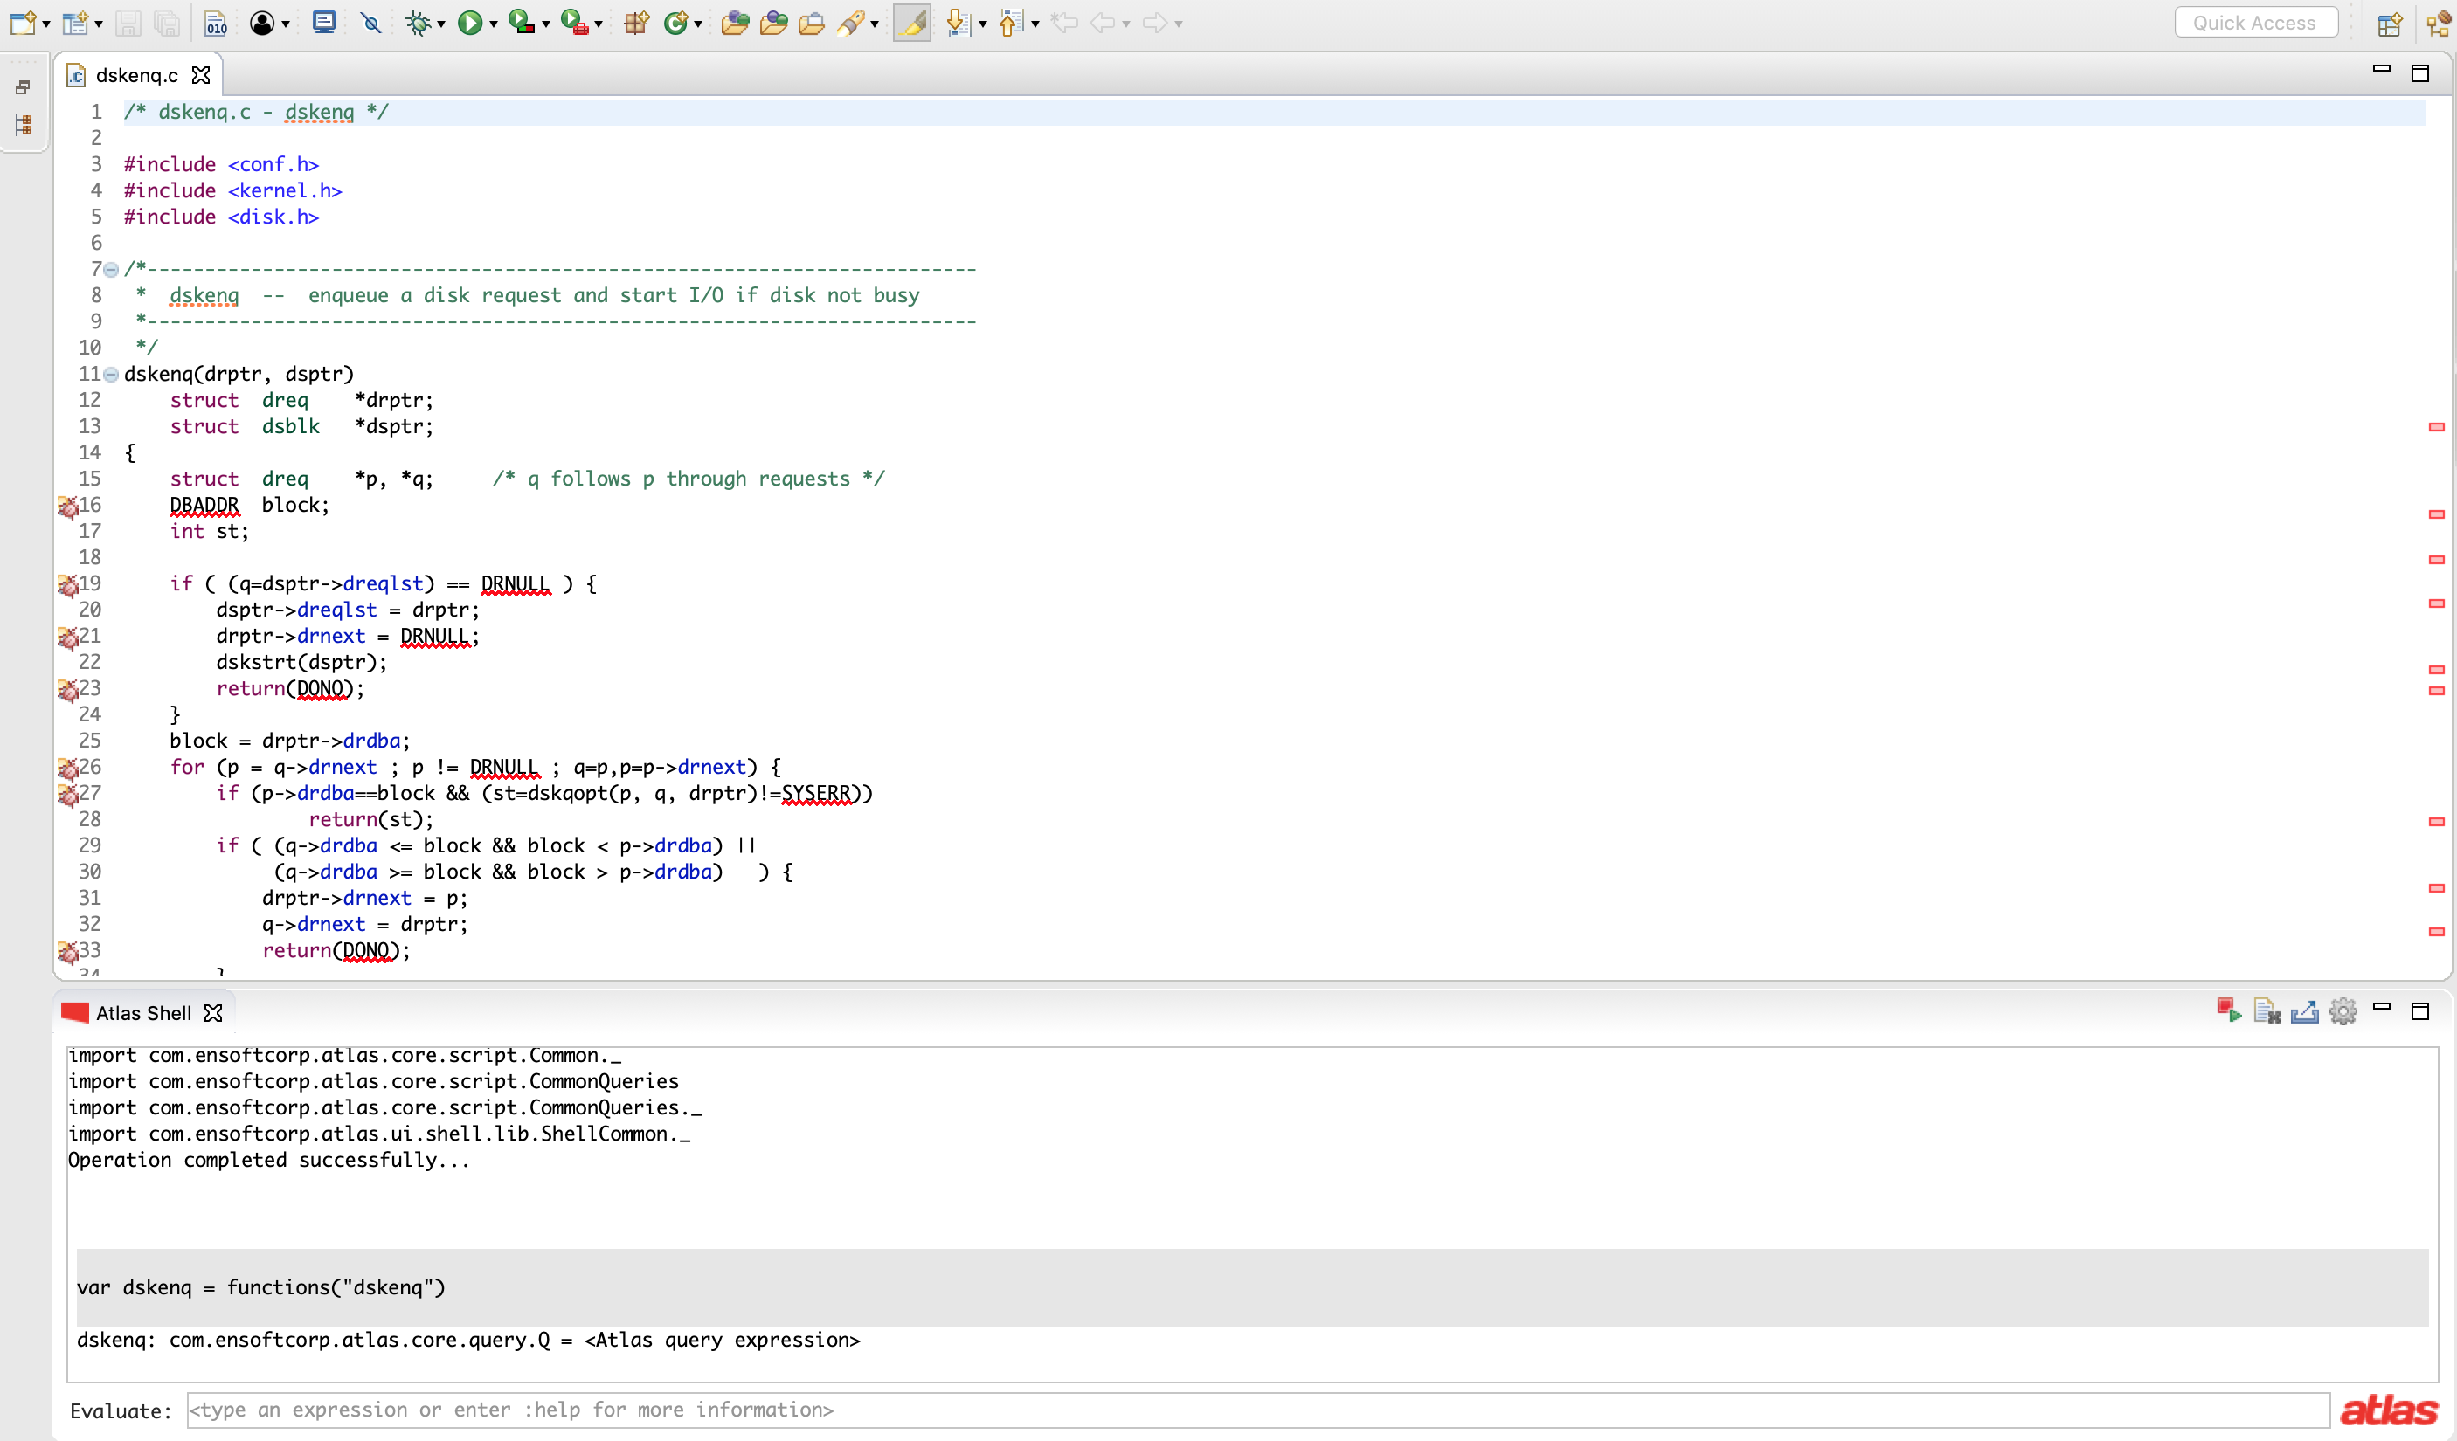
Highlight and Modify a Graph
1. var dskenq = functions("dskenq")

Slide 41
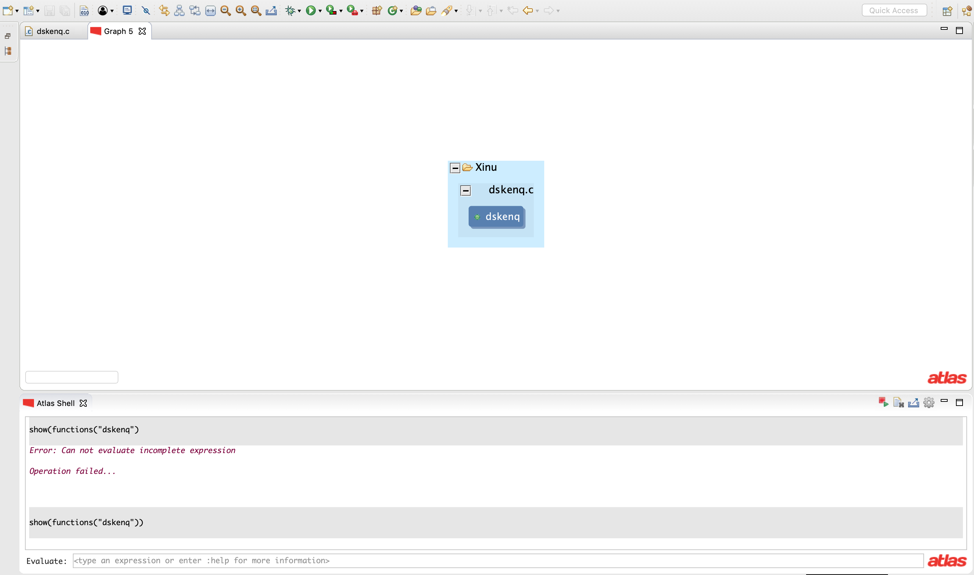
var dskenq = functions("dskenq")
show(dskenq)

Slide 42
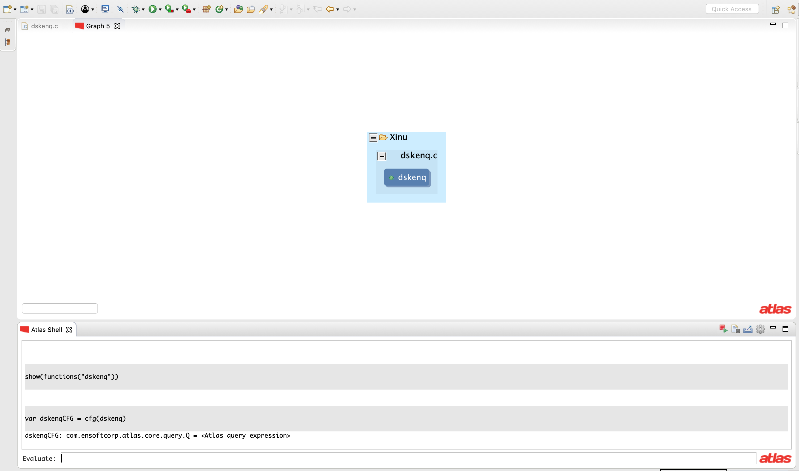
var dskenq = functions("dskenq")
show(dskenq)
var dskenqCFG = cfg(dskenq)

Slide 43
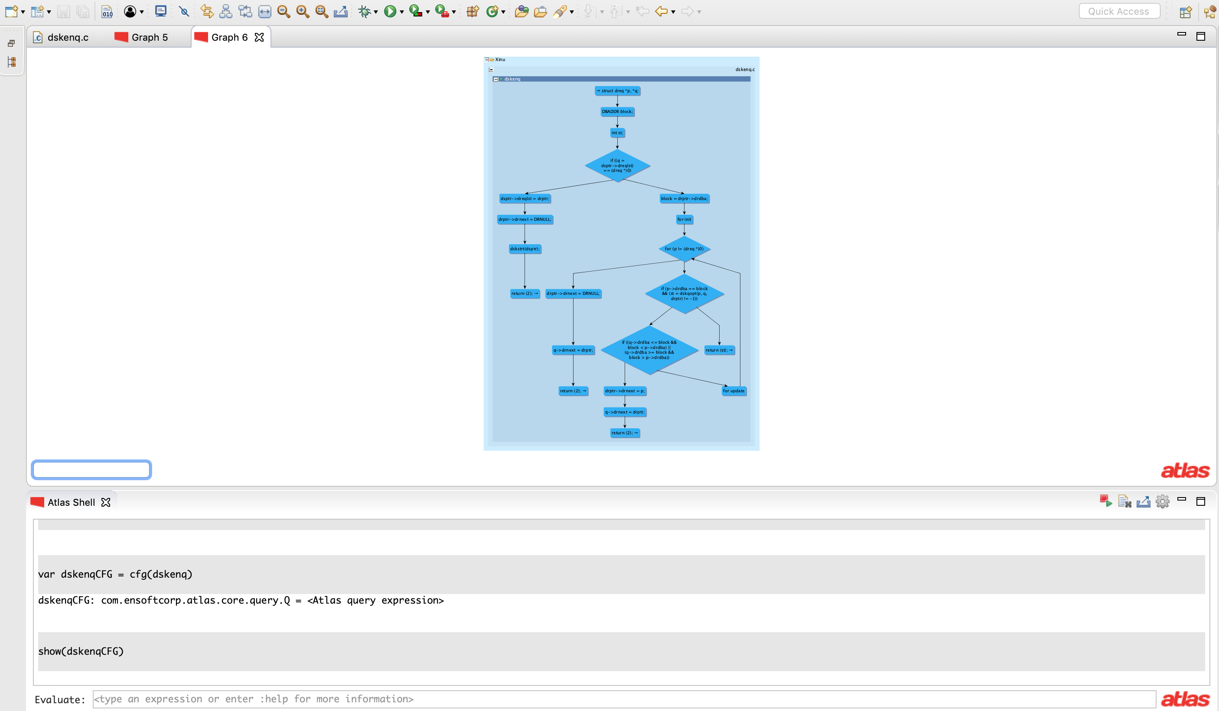
var dskenq = functions("dskenq")
show(dskenq)
var dskenqCFG = cfg(dskenq)
show(dskenqCFG)

Slide 44
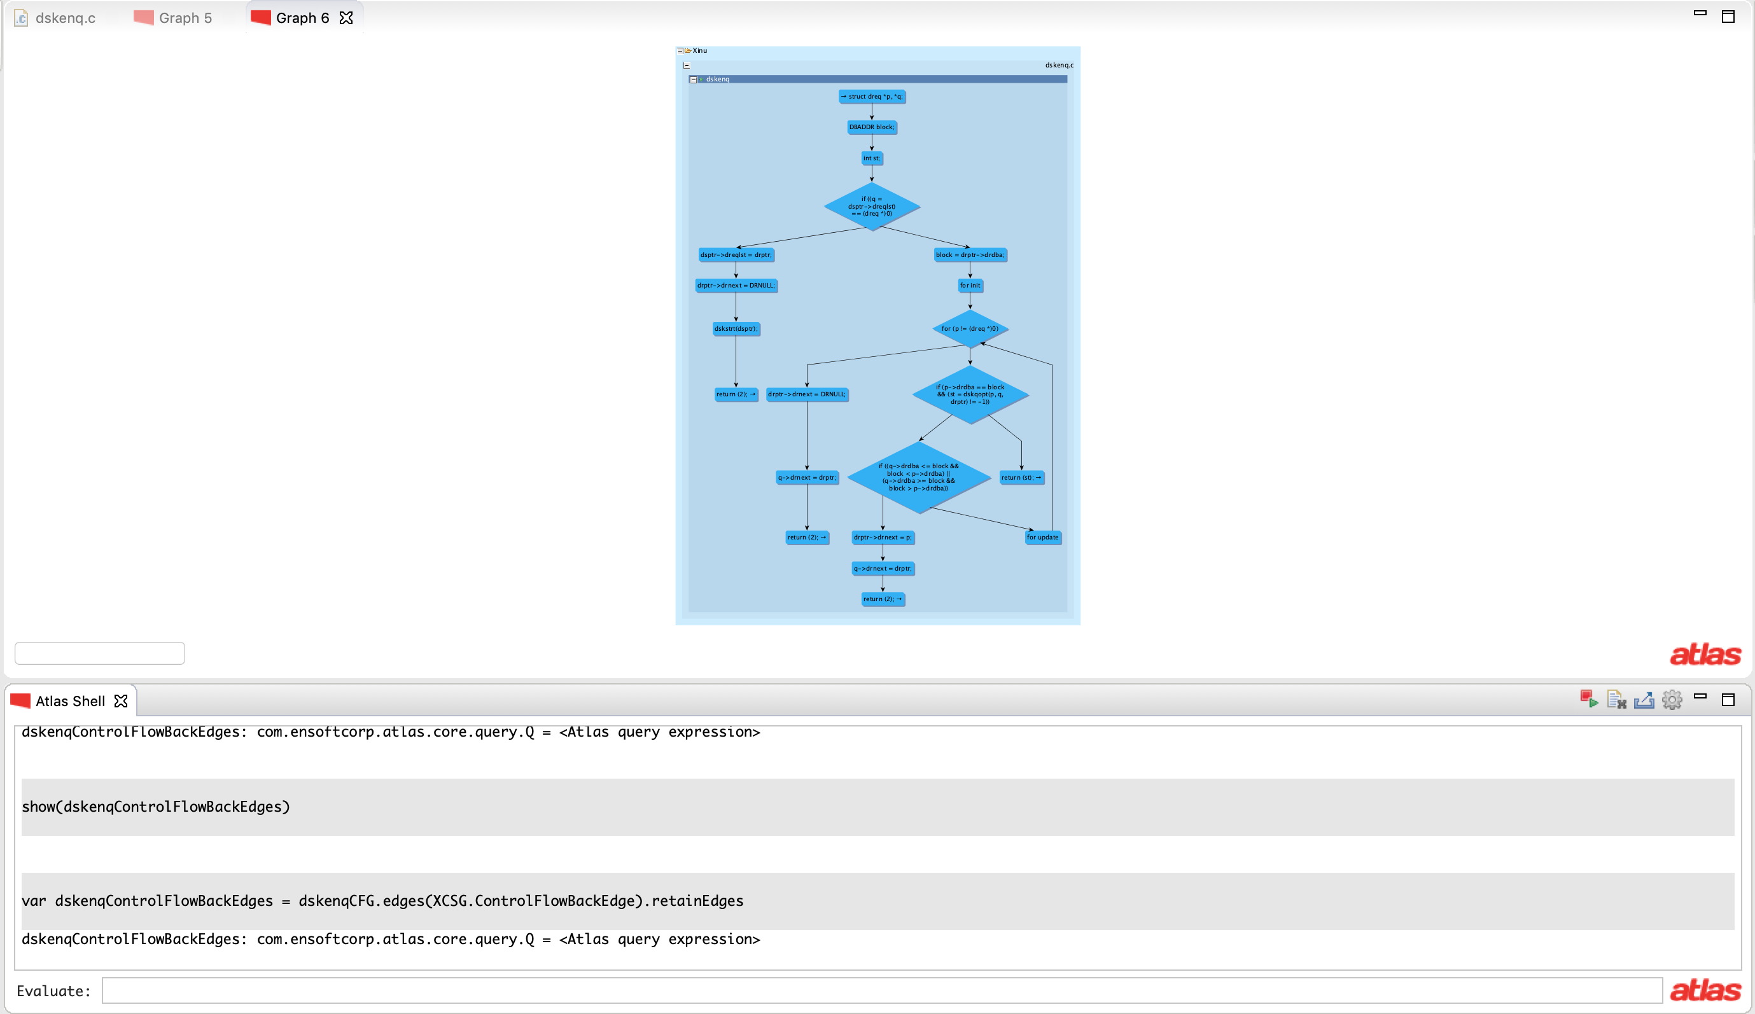
var dskenq = functions("dskenq")
show(dskenq)
var dskenqCFG = cfg(dskenq)
show(dskenqCFG)
var dskenqControlFlowBackEdges = dskenqCFG.edges(XCSG.ControlFlowBackEdge)

Slide 45
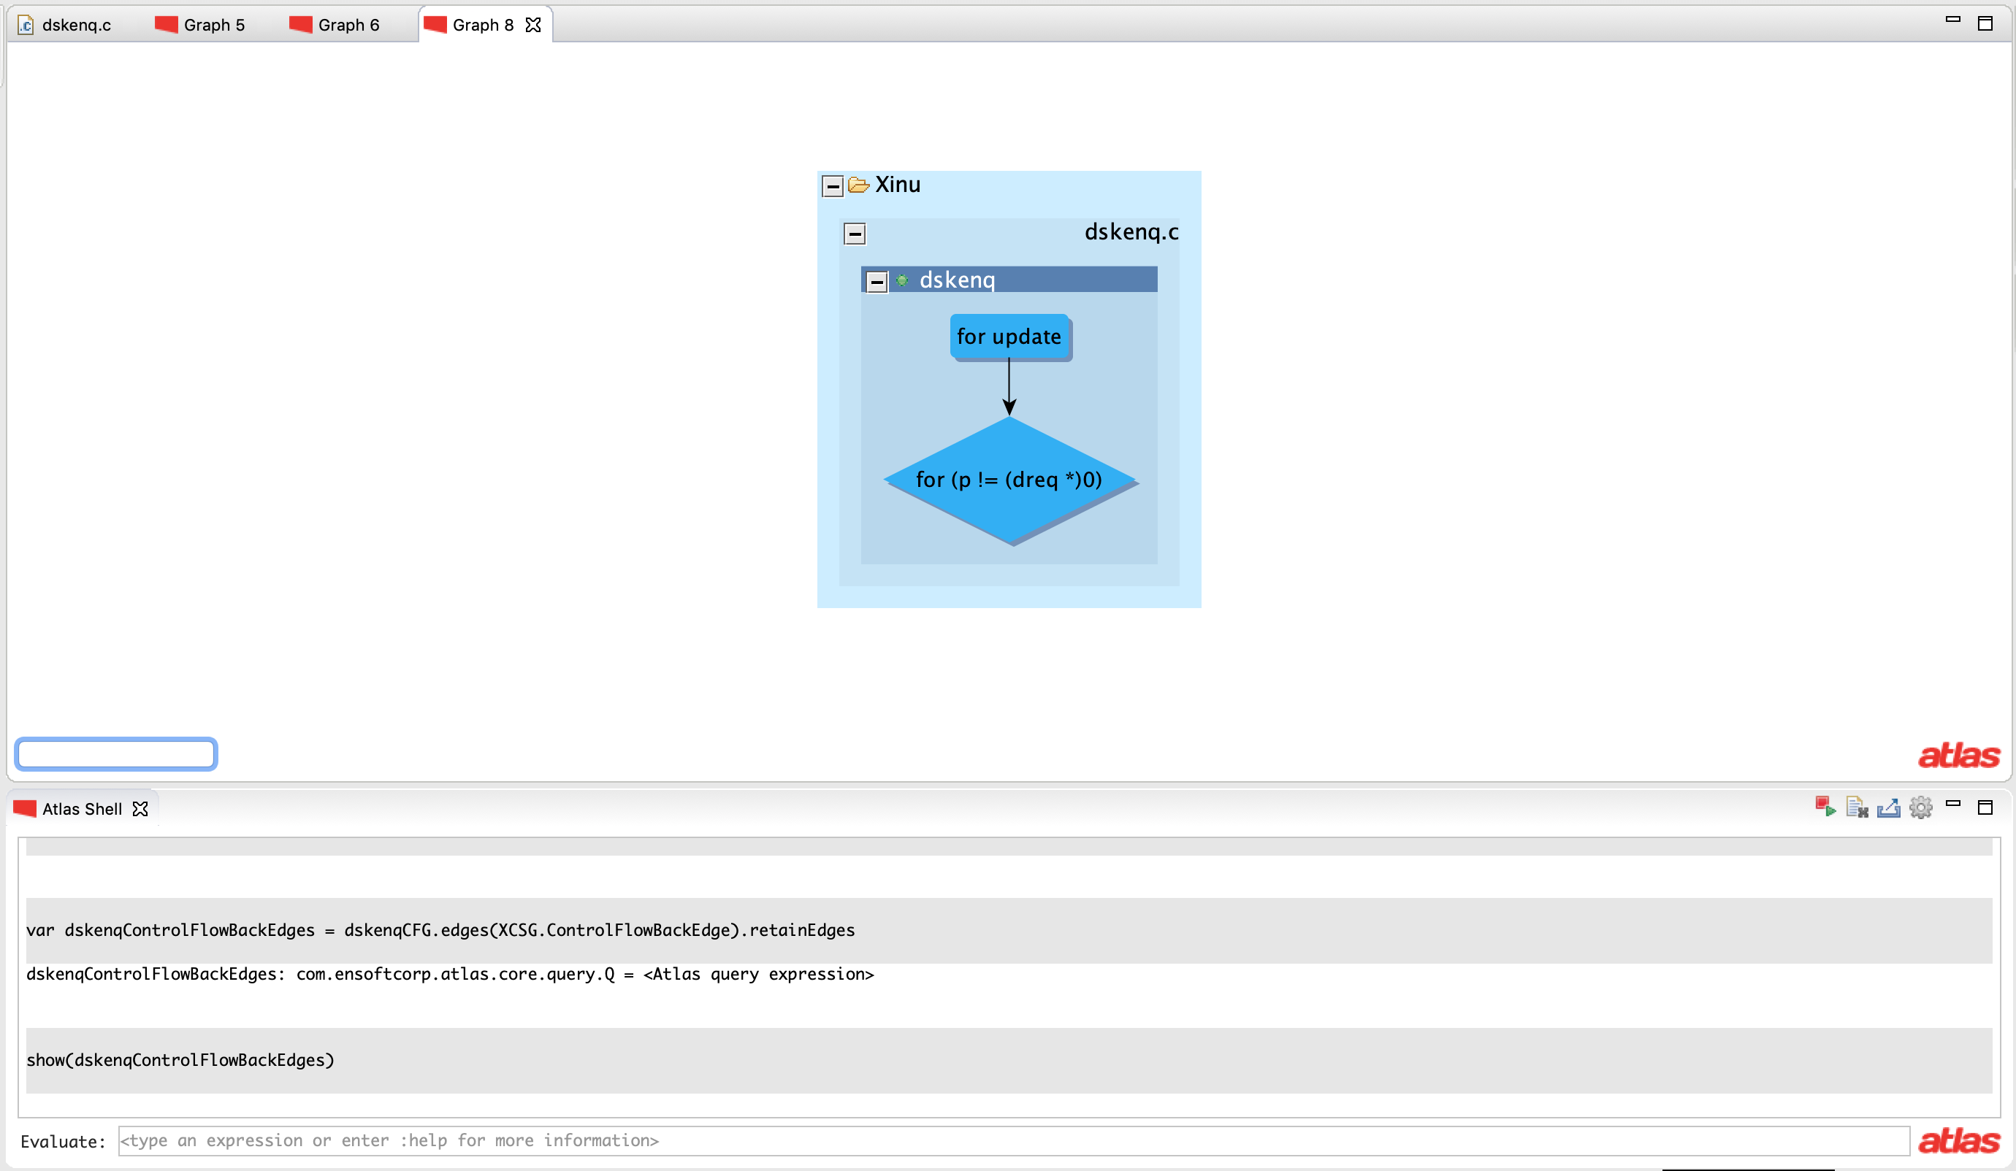
var dskenq = functions("dskenq")
show(dskenq)
var dskenqCFG = cfg(dskenq)
show(dskenqCFG)
var dskenqControlFlowBackEdges = dskenqCFG.edges(XCSG.ControlFlowBackEdge)
show(dskenqControlFlowBackEdges)

Slide 46
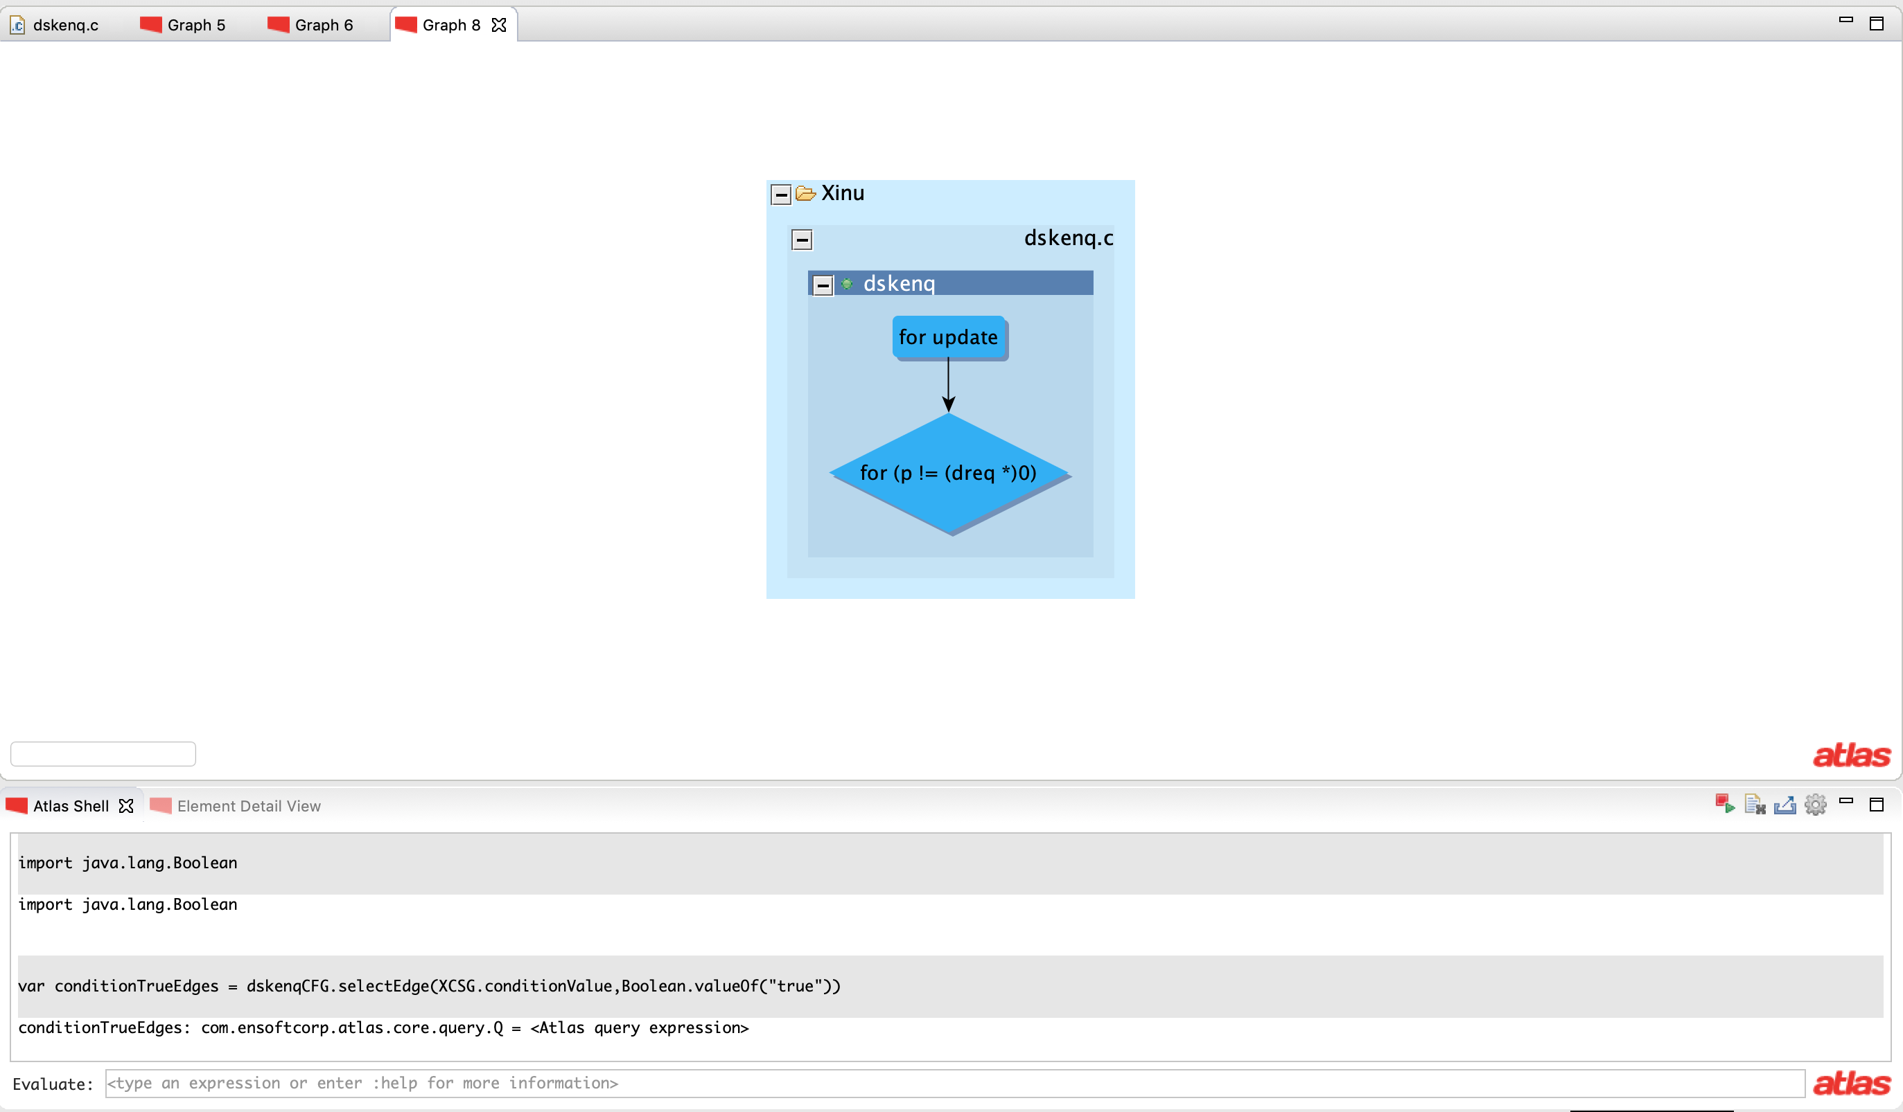
var dskenq = functions("dskenq")
show(dskenq)
var dskenqCFG = cfg(dskenq)
show(dskenqCFG)
var dskenqControlFlowBackEdges = dskenqCFG.edges(XCSG.ControlFlowBackEdge)
show(dskenqControlFlowBackEdges)
import java.lang.Boolean
var conditionTrueEdges = dskenqCFG.selectEdge(XCSG.conditionValue,Boolean.valueOf("true"))
You need this query to use Boolean.valueOf()

Slide 47
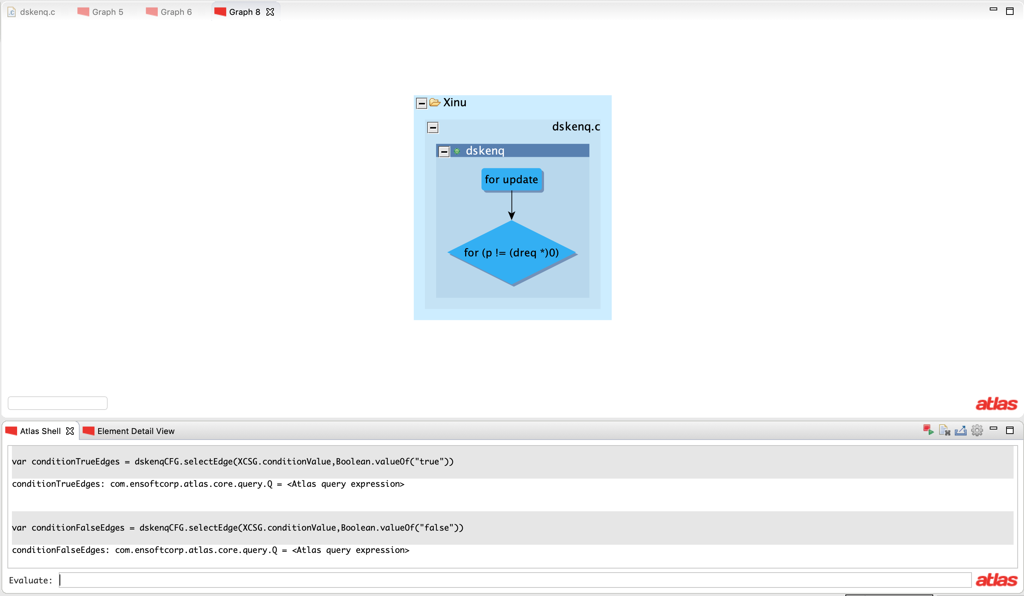
var dskenq = functions("dskenq")
show(dskenq)
var dskenqCFG = cfg(dskenq)
show(dskenqCFG)
var dskenqControlFlowBackEdges = dskenqCFG.edges(XCSG.ControlFlowBackEdge)
show(dskenqControlFlowBackEdges)
import java.lang.Boolean
var conditionTrueEdges = dskenqCFG.selectEdge(XCSG.conditionValue,Boolean.valueOf("true")
var conditionFalseEdges = dskenqCFG.selectEdge(XCSG.conditionValue,Boolean.valueOf("false"))

Slide 48
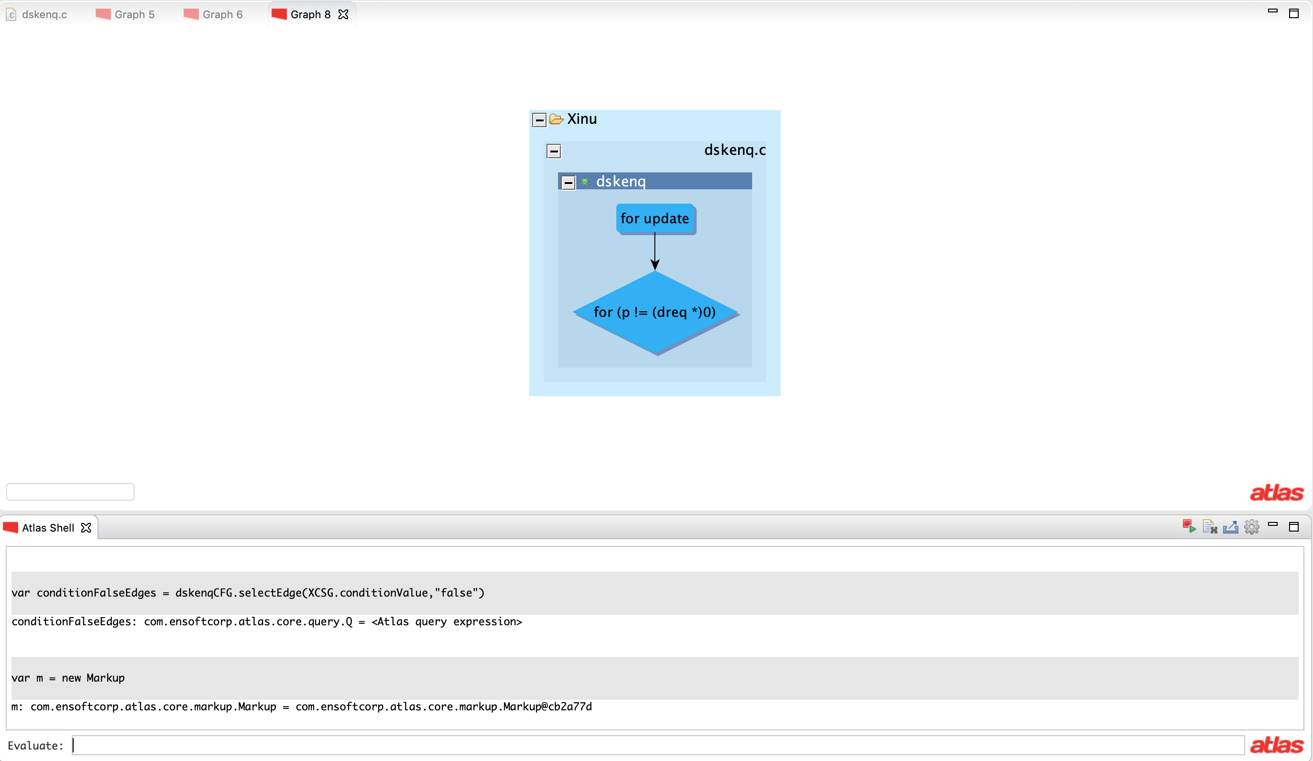
var m = new Markup
var dskenq = functions("dskenq")
show(dskenq)
var dskenqCFG = cfg(dskenq)
show(dskenqCFG)
var dskenqControlFlowBackEdges = dskenqCFG.edges(XCSG.ControlFlowBackEdge)
show(dskenqControlFlowBackEdges)
import java.lang.Boolean
var conditionTrueEdges = dskenqCFG.selectEdge(XCSG.conditionValue,Boolean.valueOf("true")
var conditionFalseEdges = dskenqCFG.selectEdge(XCSG.conditionValue,Boolean.valueOf("false"))

Slide 49
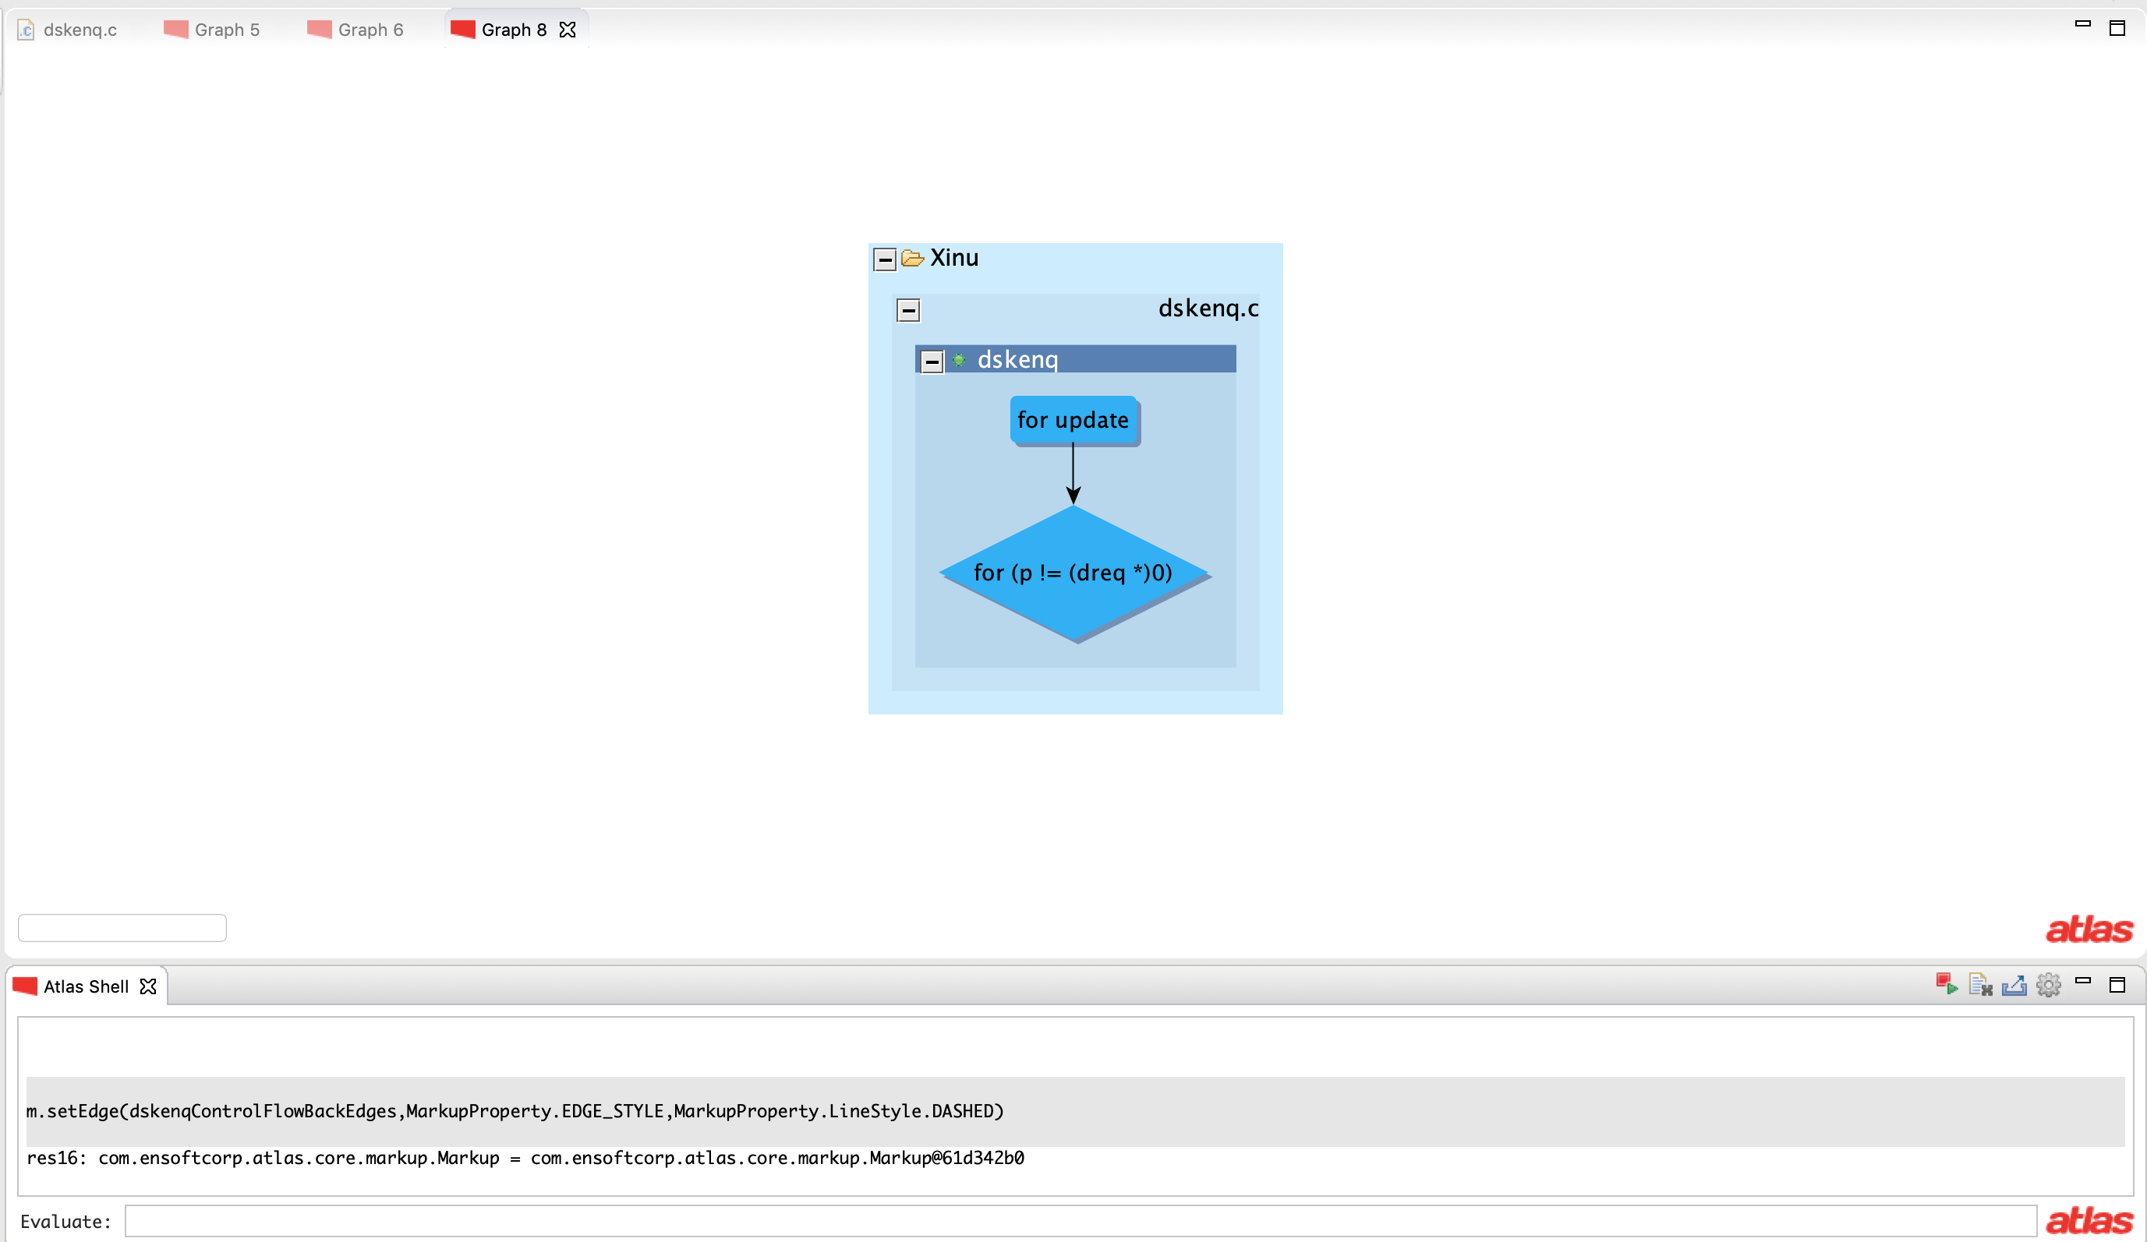
var m = new Markup
m.setEdge(dskenqControlFlowBackEdges,
MarkupProperty.EDGE_STYLE,
MarkupProperty.LineStyle.DASHED)
var dskenq = functions("dskenq")
show(dskenq)
var dskenqCFG = cfg(dskenq)
show(dskenqCFG)
var dskenqControlFlowBackEdges = dskenqCFG.edges(XCSG.ControlFlowBackEdge)
show(dskenqControlFlowBackEdges)
import java.lang.Boolean
var conditionTrueEdges = dskenqCFG.selectEdge(XCSG.conditionValue,Boolean.valueOf("true")
var conditionFalseEdges = dskenqCFG.selectEdge(XCSG.conditionValue,Boolean.valueOf("false"))

Slide 50
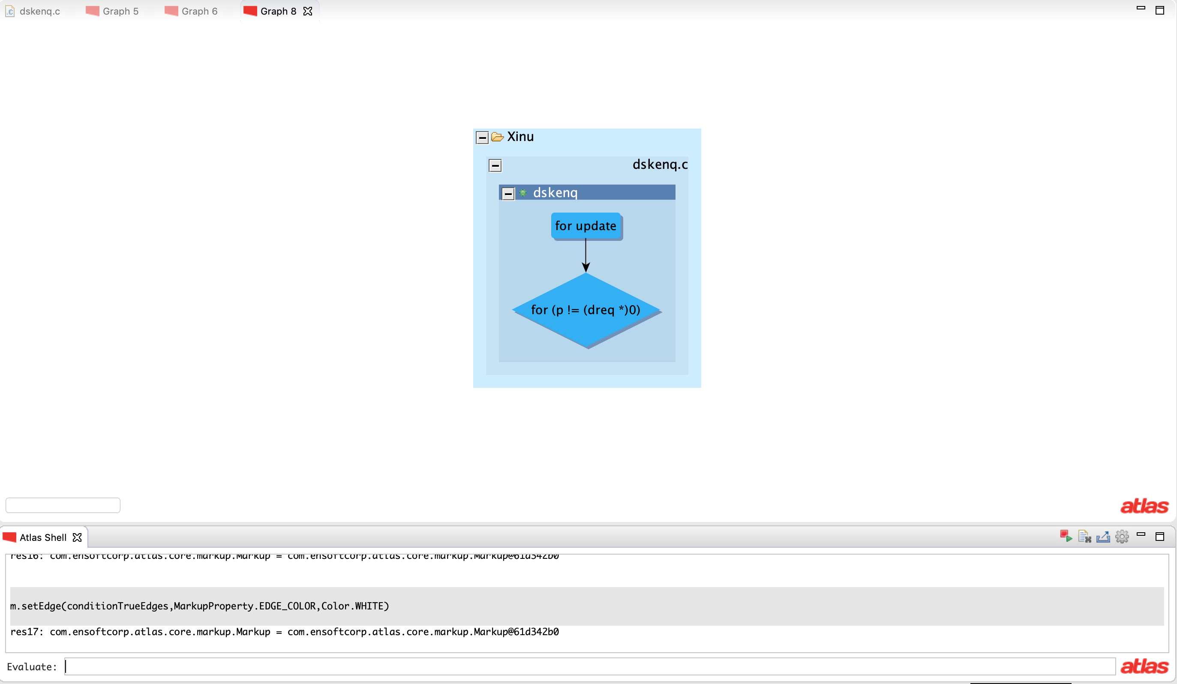
var m = new Markup
m.setEdge(dskenqControlFlowBackEdges,
MarkupProperty.EDGE_STYLE,
MarkupProperty.LineStyle.DASHED)
m.setEdge(conditionTrueEdges,
MarkupProperty.EDGE_COLOR, Color.WHITE)
var dskenq = functions("dskenq")
show(dskenq)
var dskenqCFG = cfg(dskenq)
show(dskenqCFG)
var dskenqControlFlowBackEdges = dskenqCFG.edges(XCSG.ControlFlowBackEdge)
show(dskenqControlFlowBackEdges)
import java.lang.Boolean
var conditionTrueEdges = dskenqCFG.selectEdge(XCSG.conditionValue,Boolean.valueOf("true")
var conditionFalseEdges = dskenqCFG.selectEdge(XCSG.conditionValue,Boolean.valueOf("false"))

Slide 51
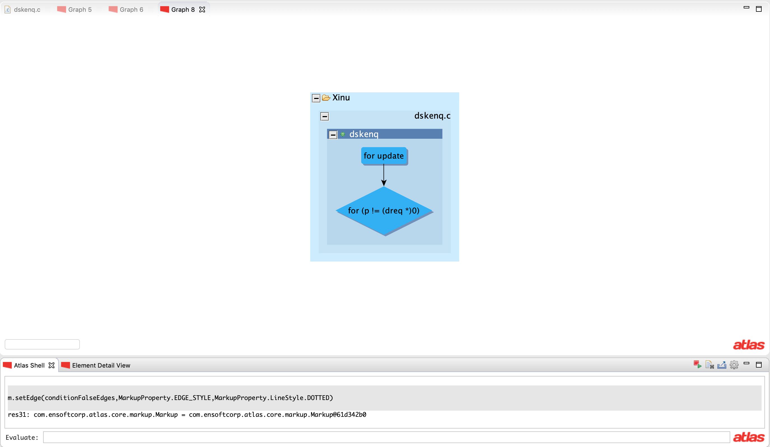
var m = new Markup
m.setEdge(dskenqControlFlowBackEdges,
MarkupProperty.EDGE_STYLE,
MarkupProperty.LineStyle.DASHED)
m.setEdge(conditionTrueEdges,
MarkupProperty.EDGE_COLOR, Color.WHITE)
m.setEdge(conditionFalseEdges,
MarkupProperty.EDGE_STYLE,
MarkupProperty.LineStyle.DOTTED)
var dskenq = functions("dskenq")
show(dskenq)
var dskenqCFG = cfg(dskenq)
show(dskenqCFG)
var dskenqControlFlowBackEdges = dskenqCFG.edges(XCSG.ControlFlowBackEdge)
show(dskenqControlFlowBackEdges)
import java.lang.Boolean
var conditionTrueEdges = dskenqCFG.selectEdge(XCSG.conditionValue,Boolean.valueOf("true")
var conditionFalseEdges = dskenqCFG.selectEdge(XCSG.conditionValue,Boolean.valueOf("false"))

Slide 52
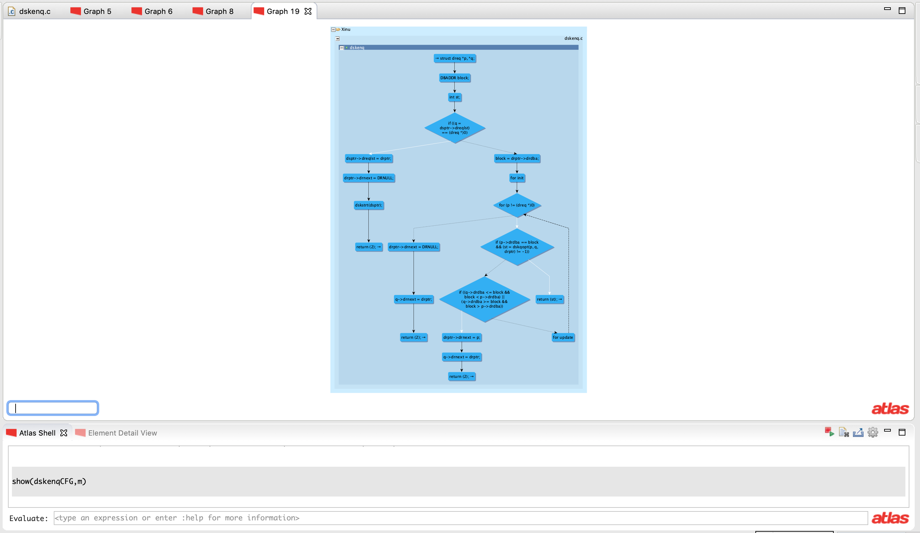
var m = new Markup
m.setEdge(dskenqControlFlowBackEdges,
MarkupProperty.EDGE_STYLE,
MarkupProperty.LineStyle.DASHED)
m.setEdge(conditionTrueEdges,
MarkupProperty.EDGE_COLOR, Color.WHITE)
m.setEdge(conditionFalseEdges,
MarkupProperty.EDGE_STYLE,
MarkupProperty.LineStyle.DOTTED)
show(dskenqCFG,m)
var dskenq = functions("dskenq")
show(dskenq)
var dskenqCFG = cfg(dskenq)
show(dskenqCFG)
var dskenqControlFlowBackEdges = dskenqCFG.edges(XCSG.ControlFlowBackEdge)
show(dskenqControlFlowBackEdges)
import java.lang.Boolean
var conditionTrueEdges = dskenqCFG.selectEdge(XCSG.conditionValue,Boolean.valueOf("true")
var conditionFalseEdges = dskenqCFG.selectEdge(XCSG.conditionValue,Boolean.valueOf("false"))

Slide 53

var m = new Markup
m.setEdge(dskenqControlFlowBackEdges,
MarkupProperty.EDGE_STYLE,
MarkupProperty.LineStyle.DASHED)
m.setEdge(conditionTrueEdges,
MarkupProperty.EDGE_COLOR, Color.WHITE)
m.setEdge(conditionFalseEdges,
MarkupProperty.EDGE_STYLE,
MarkupProperty.LineStyle.DOTTED)
show(dskenqCFG,m)
var dskenq = functions("dskenq")
show(dskenq)
var dskenqCFG = cfg(dskenq)
show(dskenqCFG)
var dskenqControlFlowBackEdges = dskenqCFG.edges(XCSG.ControlFlowBackEdge)
show(dskenqControlFlowBackEdges)
import java.lang.Boolean
var conditionTrueEdges = dskenqCFG.selectEdge(XCSG.conditionValue,Boolean.valueOf("true")
var conditionFalseEdges = dskenqCFG.selectEdge(XCSG.conditionValue,Boolean.valueOf("false"))

Slide 54
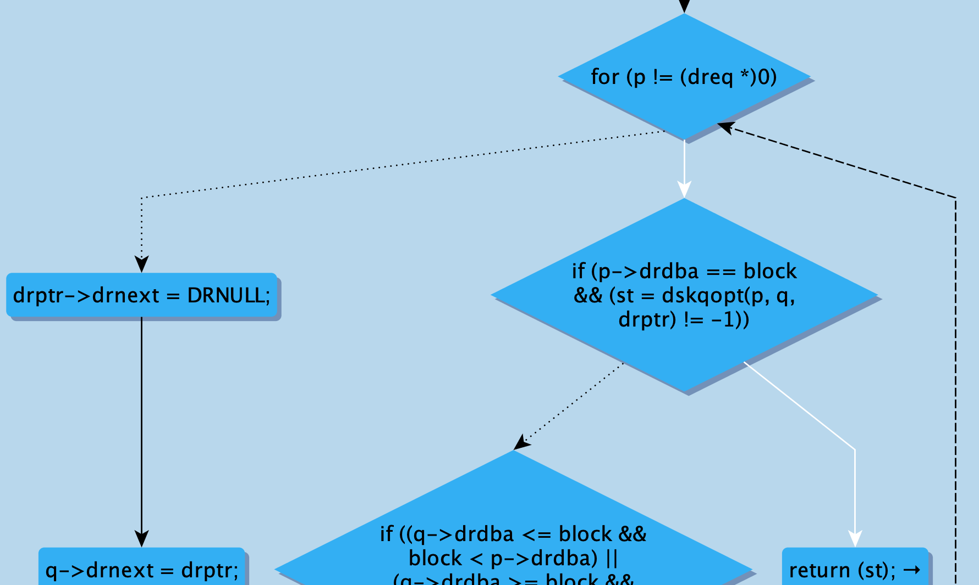

Slide 55
var m = new Markup
m.setEdge(dskenqControlFlowBackEdges,
MarkupProperty.EDGE_STYLE,
MarkupProperty.LineStyle.DASHED)
m.setEdge(conditionTrueEdges,
MarkupProperty.EDGE_COLOR, Color.WHITE)
m.setEdge(conditionFalseEdges,
MarkupProperty.EDGE_STYLE,
MarkupProperty.LineStyle.DOTTED)
show(dskenqCFG,m)
var acyclic_dskenqCFG = dskenqCFG.differenceEdges(dskenqControlFlowBackEdges)
var dskenq = functions("dskenq")
show(dskenq)
var dskenqCFG = cfg(dskenq)
show(dskenqCFG)
var dskenqControlFlowBackEdges = dskenqCFG.edges(XCSG.ControlFlowBackEdge)
show(dskenqControlFlowBackEdges)
import java.lang.Boolean
var conditionTrueEdges = dskenqCFG.selectEdge(XCSG.conditionValue,Boolean.valueOf("true")
var conditionFalseEdges = dskenqCFG.selectEdge(XCSG.conditionValue,Boolean.valueOf("false"))

Slide 56
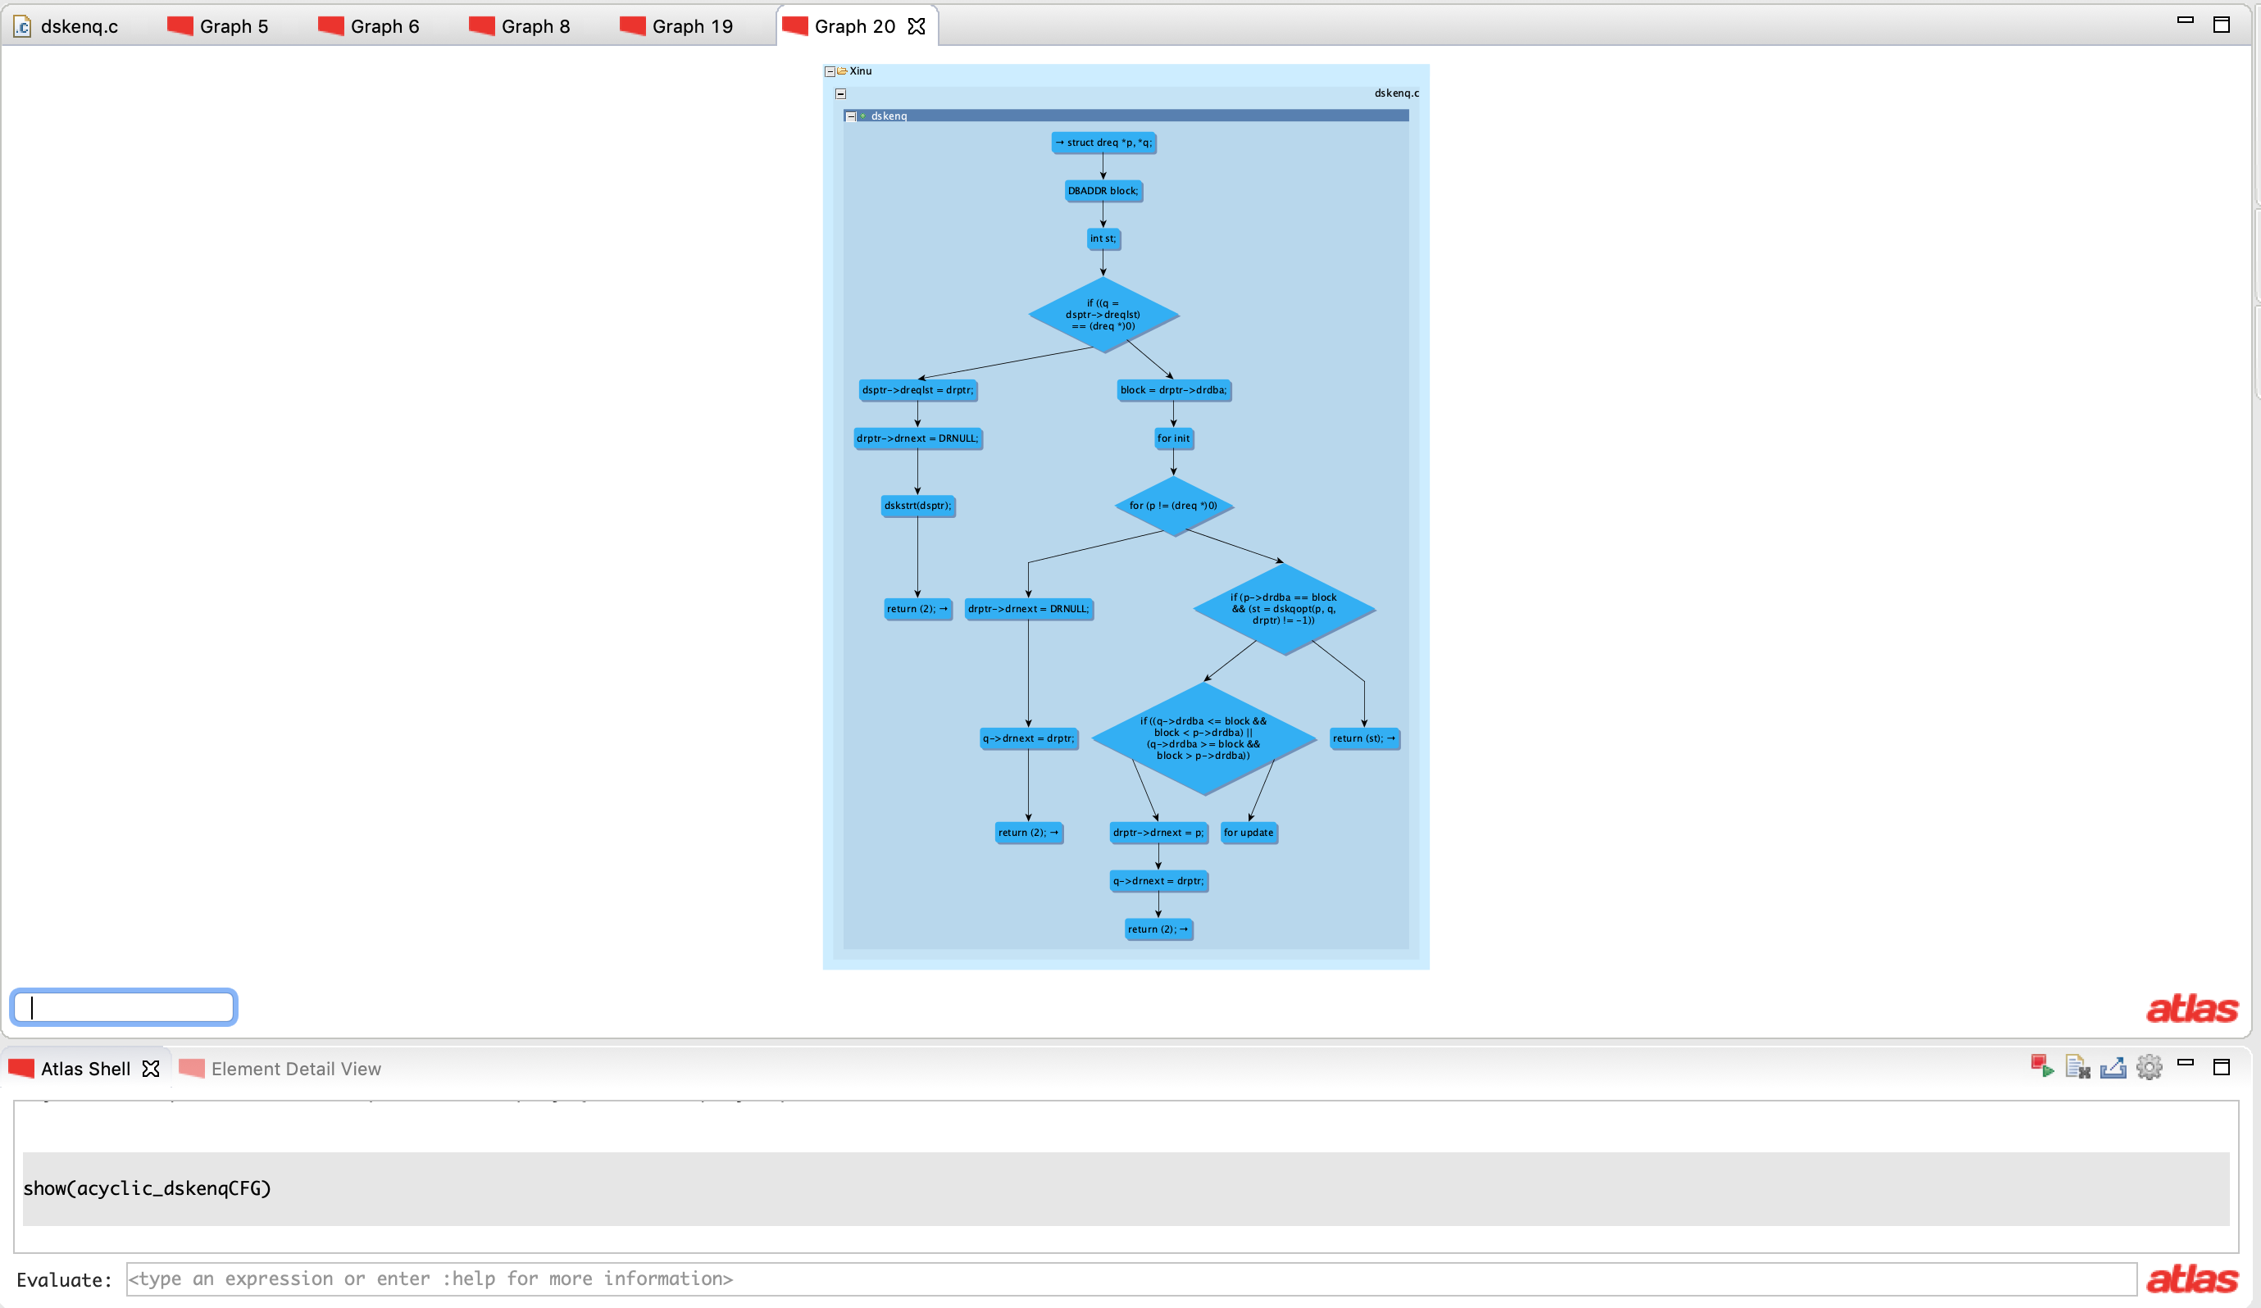
var m = new Markup
m.setEdge(dskenqControlFlowBackEdges,
MarkupProperty.EDGE_STYLE,
MarkupProperty.LineStyle.DASHED)
m.setEdge(conditionTrueEdges,
MarkupProperty.EDGE_COLOR, Color.WHITE)
m.setEdge(conditionFalseEdges,
MarkupProperty.EDGE_STYLE,
MarkupProperty.LineStyle.DOTTED)
show(dskenqCFG,m)
var acyclic_dskenqCFG = dskenqCFG.differenceEdges(dskenqControlFlowBackEdges)
show(acyclic_dskenqCFG)
var dskenq = functions("dskenq")
show(dskenq)
var dskenqCFG = cfg(dskenq)
show(dskenqCFG)
var dskenqControlFlowBackEdges = dskenqCFG.edges(XCSG.ControlFlowBackEdge)
show(dskenqControlFlowBackEdges)
import java.lang.Boolean
var conditionTrueEdges = dskenqCFG.selectEdge(XCSG.conditionValue,Boolean.valueOf("true")
var conditionFalseEdges = dskenqCFG.selectEdge(XCSG.conditionValue,Boolean.valueOf("false"))

Slide 57
var dskenq = functions("dskenq")
show(dskenq)
var dskenqCFG = cfg(dskenq)
show(dskenqCFG)
var dskenqControlFlowBackEdges = dskenqCFG.edges(XCSG.ControlFlowBackEdge)
show(dskenqControlFlowBackEdges)
import java.lang.Boolean
var conditionTrueEdges = dskenqCFG.selectEdge(XCSG.conditionValue,Boolean.valueOf("true")
var conditionFalseEdges = dskenqCFG.selectEdge(XCSG.conditionValue,Boolean.valueOf("false"))
Note the absence of the loop back-edge

Slide 58
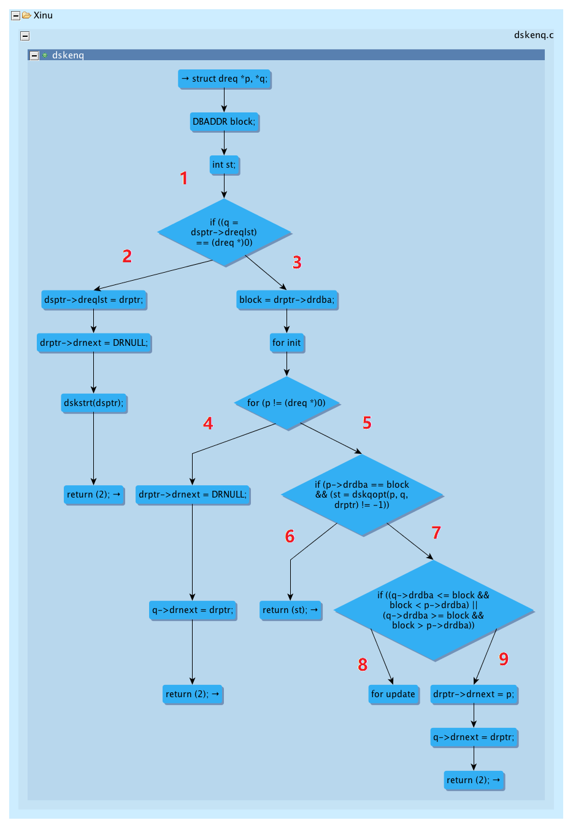
Path I: 1, 2
Path II: 1, 3, 4,
Path III: 1, 3, 5, 6
Path IV: 1, 3, 5, 7, 8
Path V: 1, 3, 5, 7, 9

Slide 59
Appendix: Highlighting selective information in Atlas
Sometime, you want to mark a particular information on graphs generated by Atlas but you may not have query for it. This can still be done using the keyword selected.
Selected
Whenever you click on a node or edge in an Atlas Graph, this selection is stored in Atlas in a special variable. This variable is referenced using the keyword selected. We will demonstrate the use of it by marking loop entry and exit nodes in a graph.

Slide 60
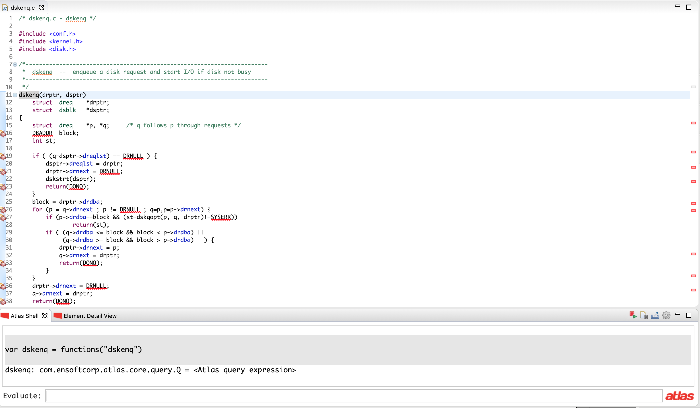
var dskenq = functions("dskenq")

Slide 61

var dskenq = functions("dskenq")
var dskenqCFG = cfg(dskenq)

Slide 62

var dskenq = functions("dskenq")
var dskenqCFG = cfg(dskenq)
show(dskenqCFG)

Slide 63

Click on the node to select it. After you select the node, it can be referred using keyword selected
var dskenq = functions("dskenq")
var dskenqCFG = cfg(dskenq)
show(dskenqCFG)
var loopEntry = selected

Slide 64

Press and Hold shift to make multiple selections.
var dskenq = functions("dskenq")
var dskenqCFG = cfg(dskenq)
show(dskenqCFG)
var loopEntry = selected
var loopExits = selected

Slide 65

var dskenq = functions("dskenq")
var dskenqCFG = cfg(dskenq)
show(dskenqCFG)
var loopEntry = selected
var loopExits = selected
var m = new Markup

Slide 66

var dskenq = functions("dskenq")
var dskenqCFG = cfg(dskenq)
show(dskenqCFG)
var loopEntry = selected
var loopExits = selected
var m = new Markup
m.setNode(loopEntry,
MarkupProperty.NODE_BACKGROUND_COLOR,
Color.YELLOW)

Slide 67

var dskenq = functions("dskenq")
var dskenqCFG = cfg(dskenq)
show(dskenqCFG)
var loopEntry = selected
var loopExits = selected
var m = new Markup
m.setNode(loopEntry,
MarkupProperty.NODE_BACKGROUND_COLOR,
Color.YELLOW)
m.setNode(loopExits,
MarkupProperty.NODE_BACKGROUND_COLOR,
Color.RED)

Slide 68

var dskenq = functions("dskenq")
var dskenqCFG = cfg(dskenq)
show(dskenqCFG)
var loopEntry = selected
var loopExits = selected
var m = new Markup
m.setNode(loopEntry,MarkupProperty.NODE_BACKGROUND_COLOR,
Color.YELLOW)
m.setNode(loopExits,MarkupProperty.NODE_BACKGROUND_COLOR,
Color.RED)
show(dskenqCFG,m)

Slide 69

Click this to save the Graph.

